Slide 1
Teachers This guide is for a workshop at the National War Museum. You can edit and adapt to use with your class.

Slide 2
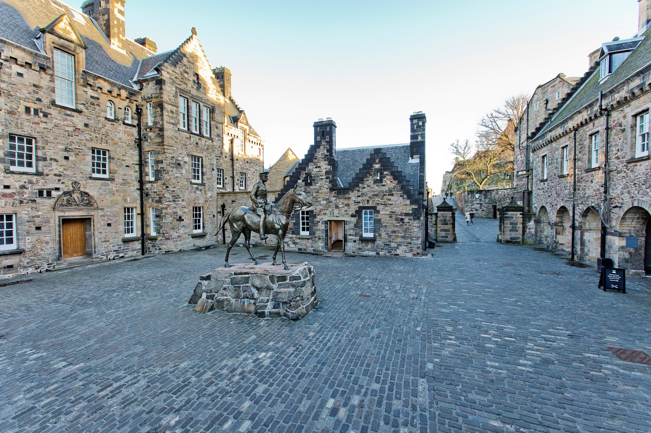
We are going to the National War Museum
Notes:
©Ruth Armstrong Photography

Slide 3
The National War Museum is in Edinburgh Castle.

Slide 4
We are visiting the National War Museum on
We will be leaving school at

Slide 5
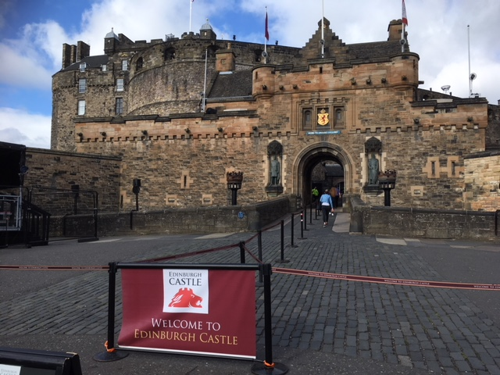
Castle Entrance
We will arrive at Edinburgh Castle and meet the Enabler running our workshop here, just to the left of the drawbridge. The Enabler will give us our tickets.

Slide 6
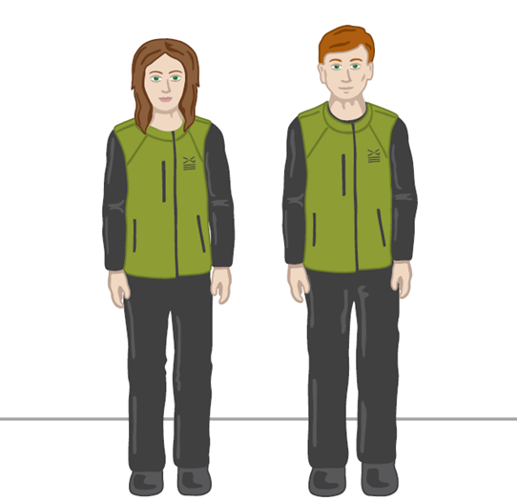
Enablers wear this uniform. They will be introducing our session today.
Enabler

Slide 7
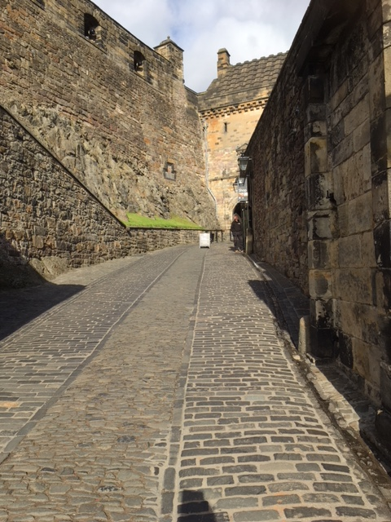
Ticket Collection
Once we have our own individual ticket we will need to show them to the member of staff waiting here.

Slide 8
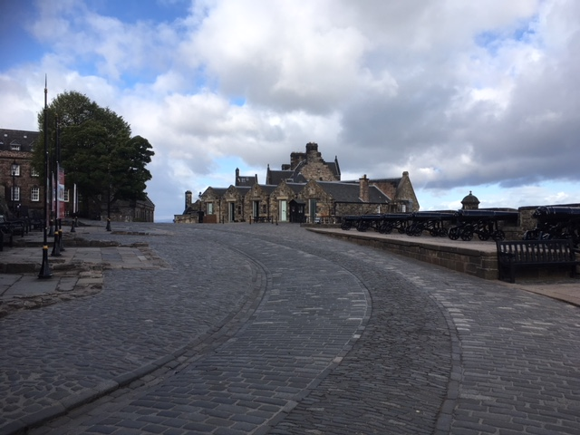
Travelling to the National War Museum
Once we have shown our tickets to enter the castle we will need to make our way along this path to the National War Museum, led by an Enabler.

Slide 9
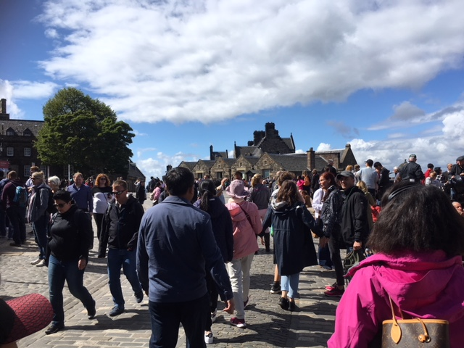
Travelling to the National War Museum
Sometimes it can be very busy so we need to make sure we stay with our adults.

Slide 10
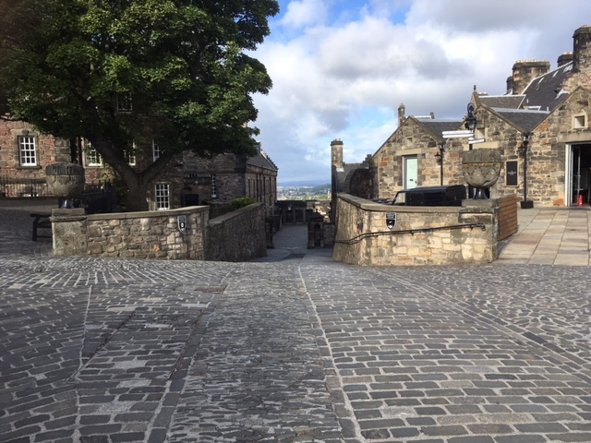
Travelling to the National War Museum
Follow the path down the hill. Please be careful as there might be some moving vehicles.

Slide 11
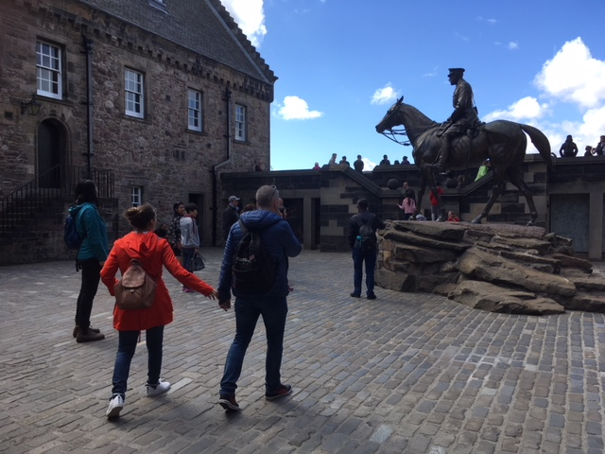
Travelling to the National War Museum
We will arrive at Hospital Square and see the statue of Earl Haig on his horse.

Slide 12
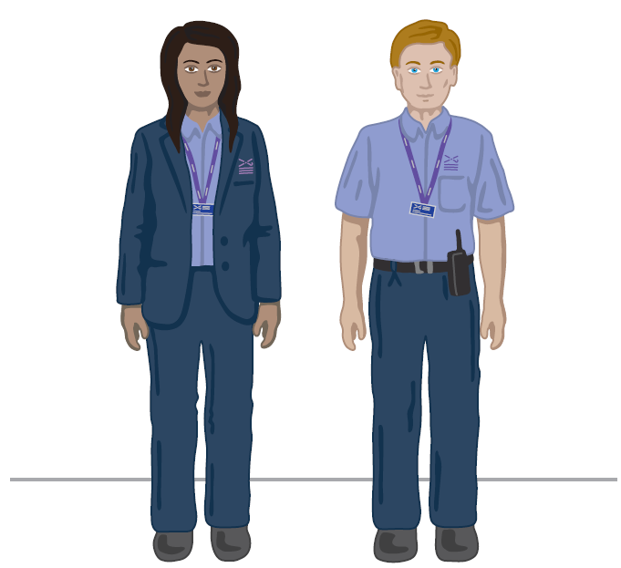
We might meet a Visitor Experience Assistant who can answer our questions or help if we need it. They wear uniforms that look like this.
Visitor Experience Assistant

Slide 13
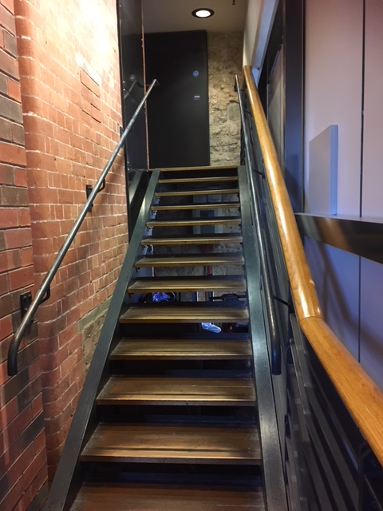
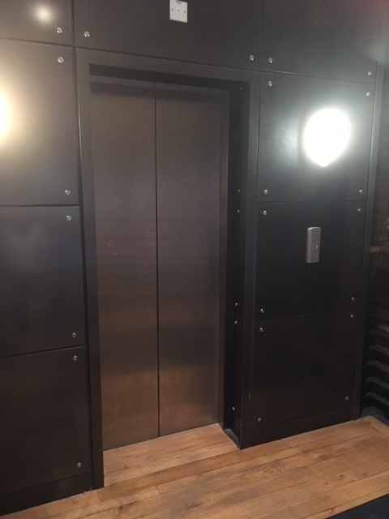
When travelling around the National War Museum we might need to use the stairs or lift.
Stairs Lift

Slide 14
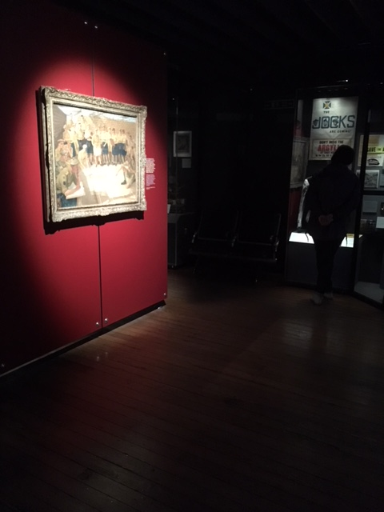
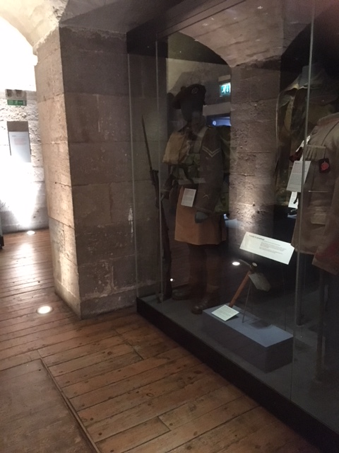
Some people might find parts of the museum quite dark.

Slide 15
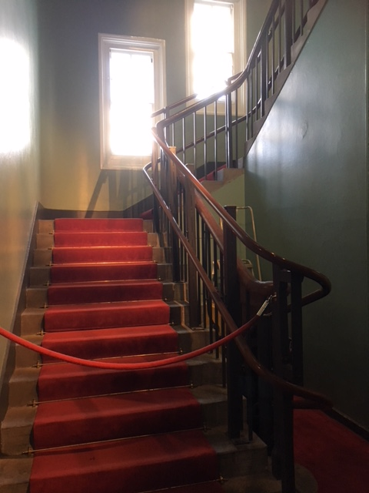
We will be using these stairs.

Slide 16
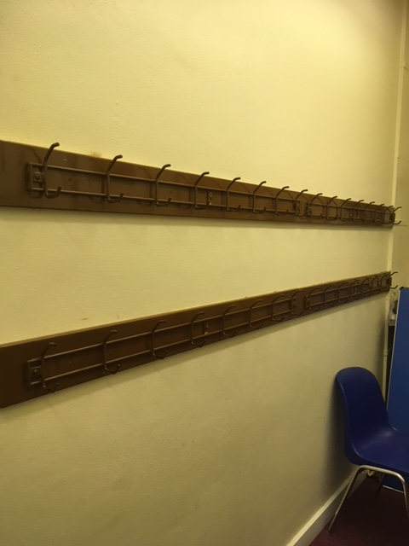
Once we reach the top of the stairs we will leave our coats and bags here.

Slide 17
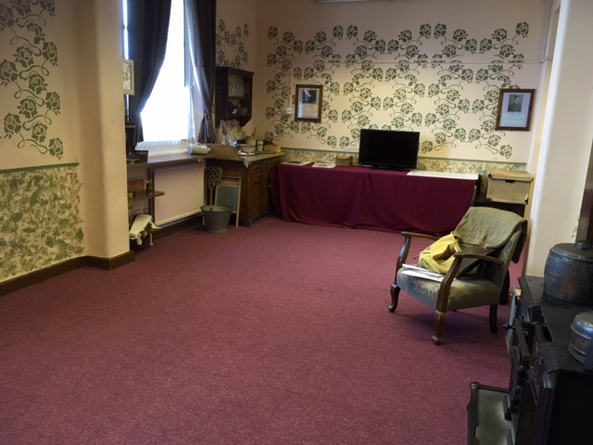
We will then be able to enter the Wartime Life Room and start our workshop.

Slide 18
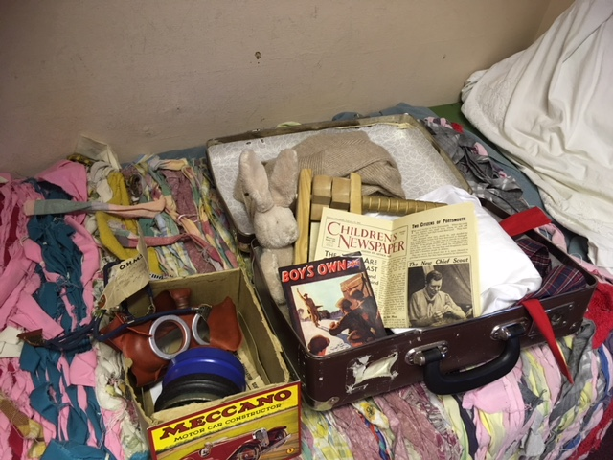
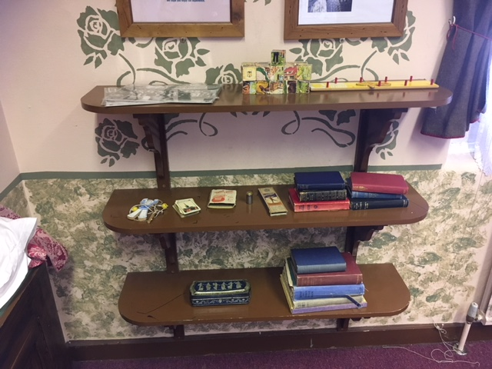
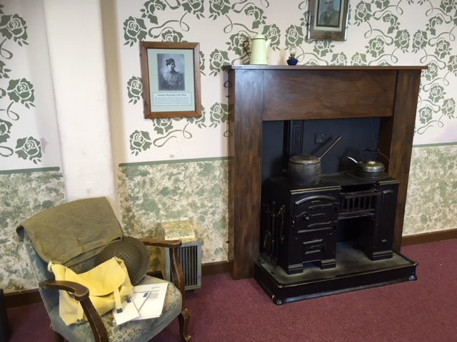
We will see lots of different objects in the room.

Slide 19
When it’s time to leave, we will collect our belongings and make our way back down the stairs.

Slide 20
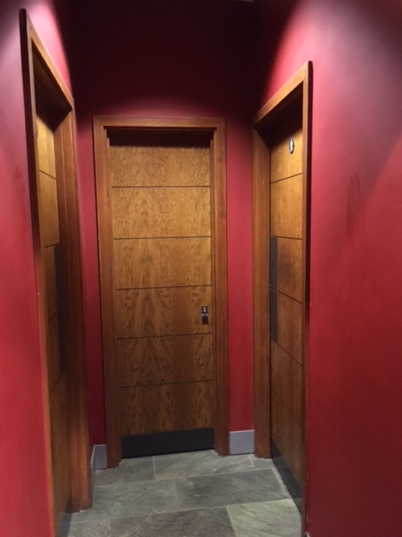
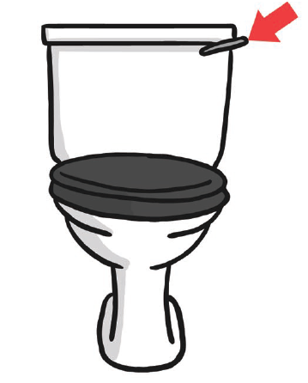
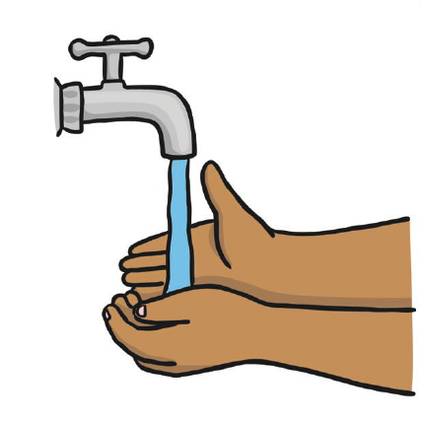
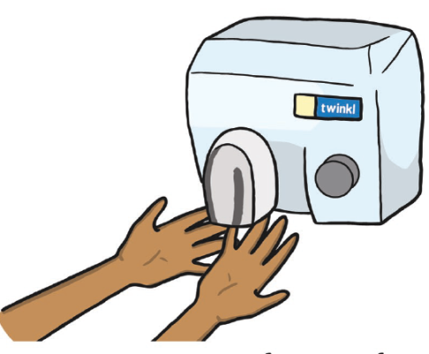
These are the toilets at the Museum.
The hand dryers are very loud.

Slide 21
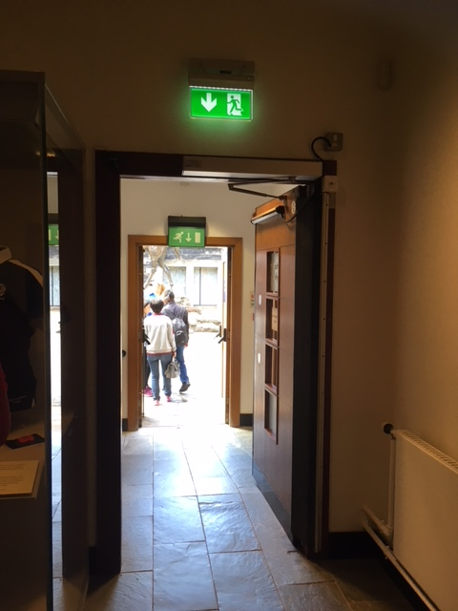
We will exit the War Museum through this door.

Slide 22
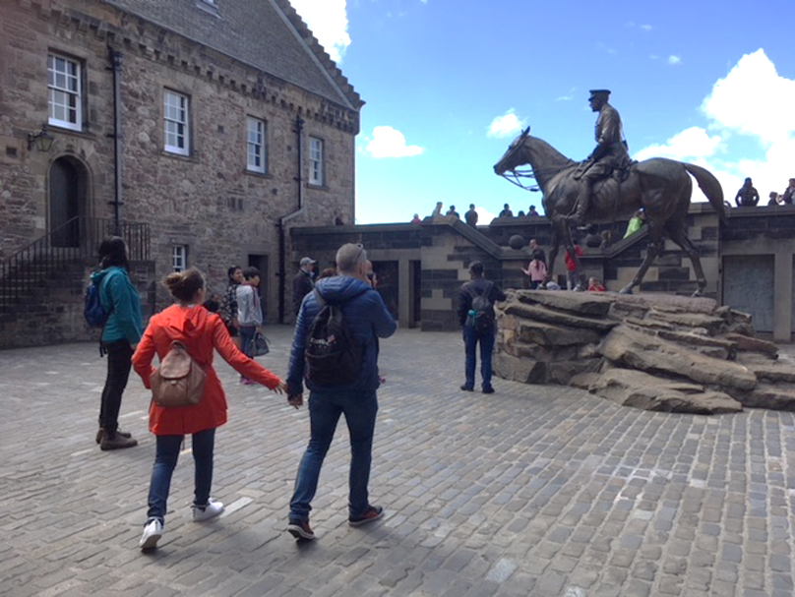
We will be back at Hospital Square ready to leave the National War Museum.

Slide 23
We can eat our lunch outside and borrow a picnic blanket to sit on. The corner of Hospital Square is a sheltered spot.

Slide 24
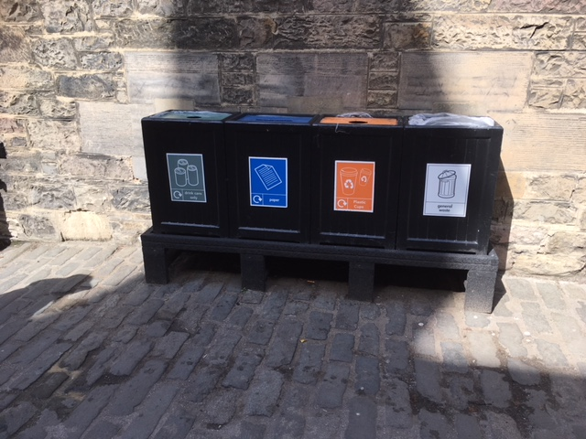
If we have any litter or recycling we can put it in the bins provided.

Slide 25
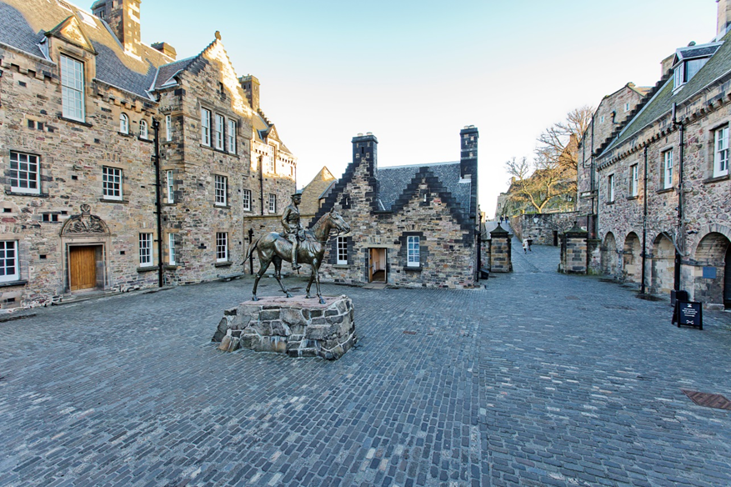
We can plan our visit by using the museum website. We can explore the rest of the Castle during our day out.

Slide 26
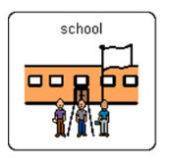
We will leave the Castle at
We will go back to school.

Slide 27
Our topic is
Add in what you are planning on looking at e.g.
WW1
WW2
If you want to add in pictures of some of the museums’ objects you can search the collections here: http://www.nms.ac.uk/explore/search-our-collections/
This could be a fun pre-visit planning activity.

