Slide 1
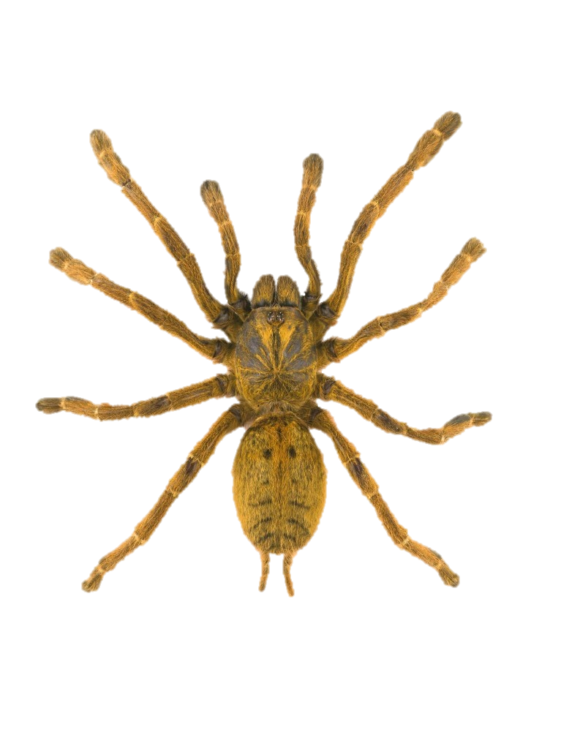
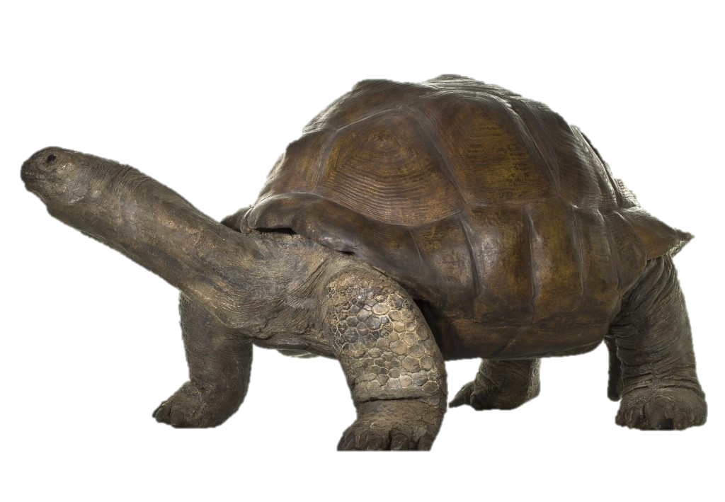
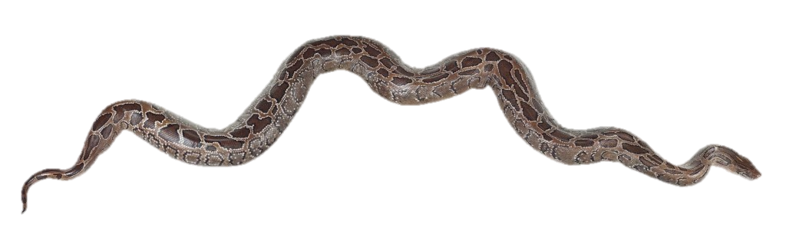
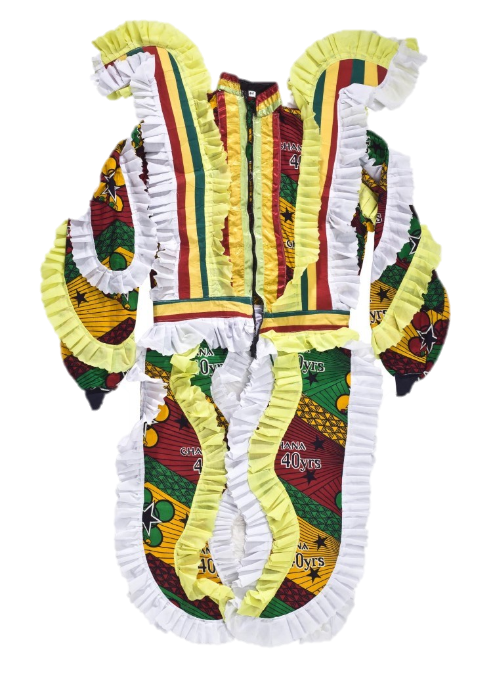
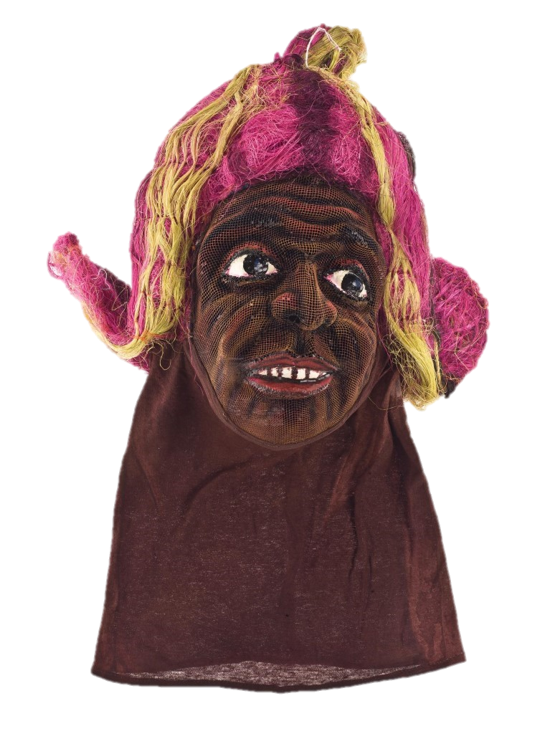
Museum Stories with Chief Chebe – Learning Activities

Slide 2
Museum Story One
Chief Chebe’s museum tour

Slide 3
Activity 1:
Create a story where a character learns a lesson

Slide 4
Chief Chebe’s story session was inspired by things and animals in the museum that brought back memories from his time in Ghana.
Can you think of something of yours that brings back a memory?
Draw the object you chose
Show your drawing to the person sitting next to you and tell them a story about it.

Slide 5
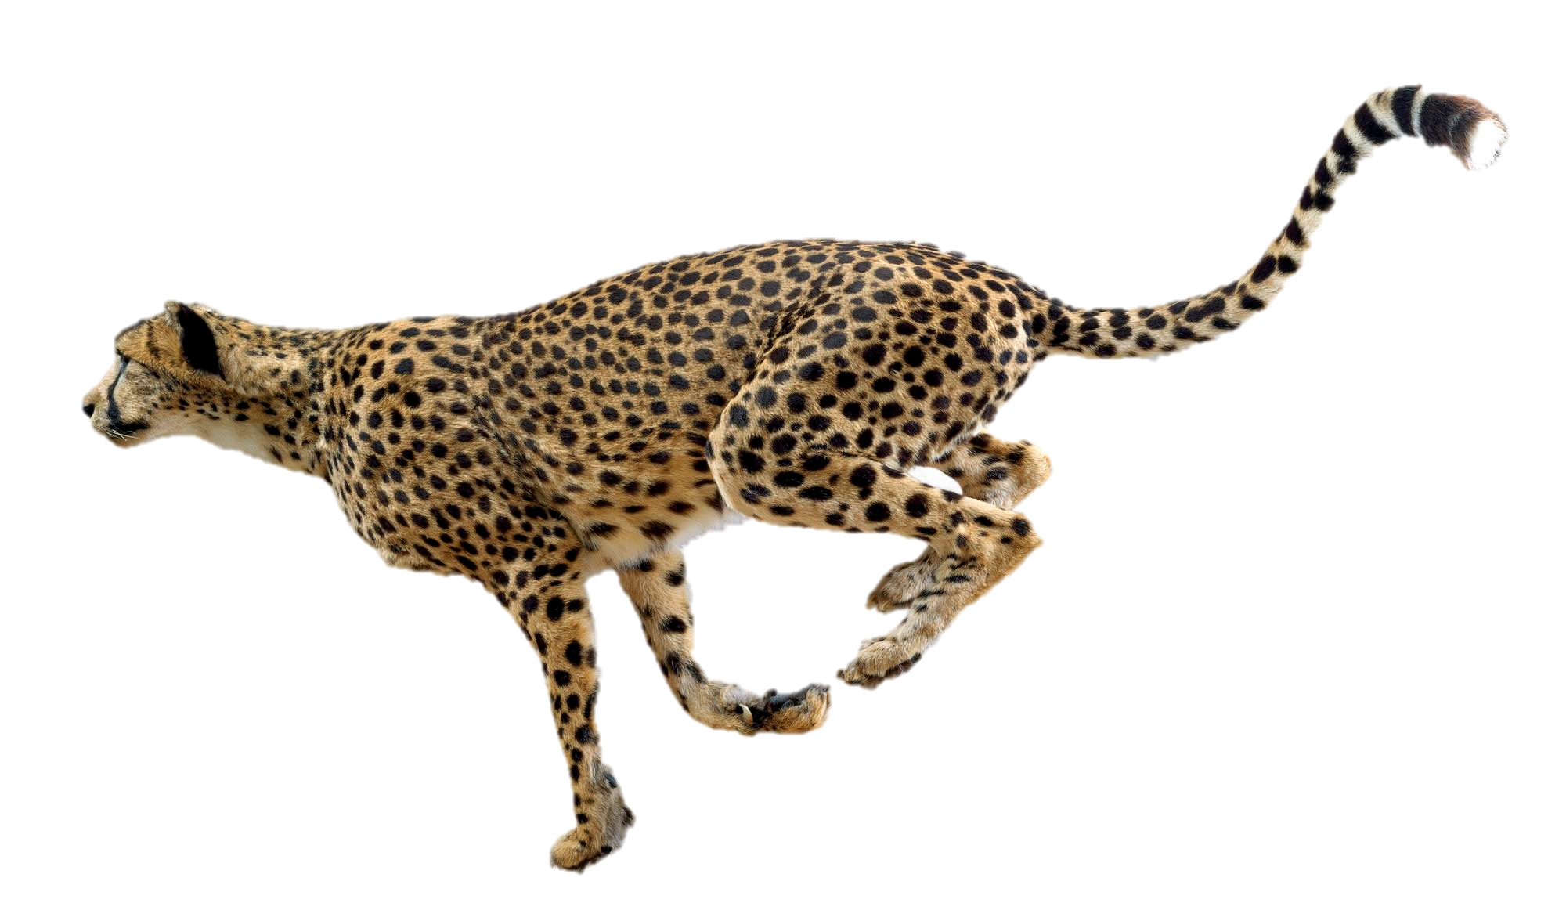
Activity 2:
Create a story about an animal based on its looks or characteristics

Slide 6
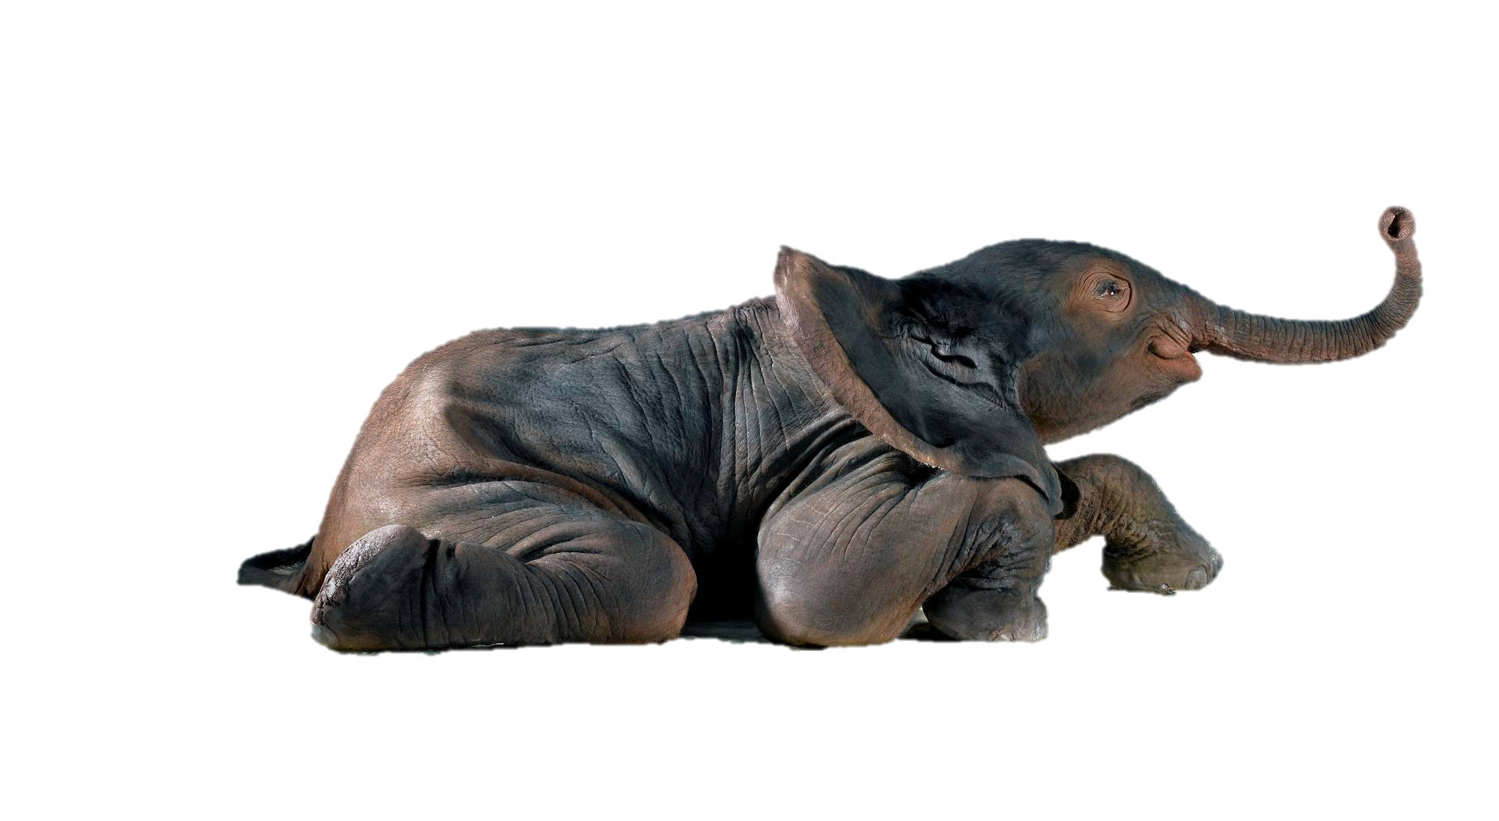
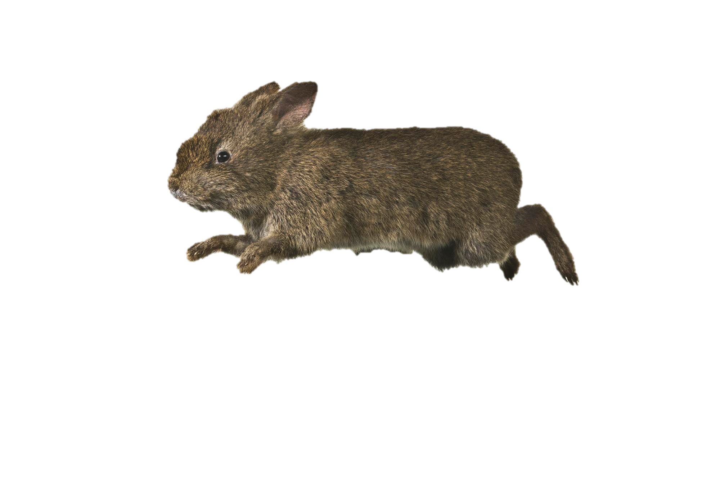
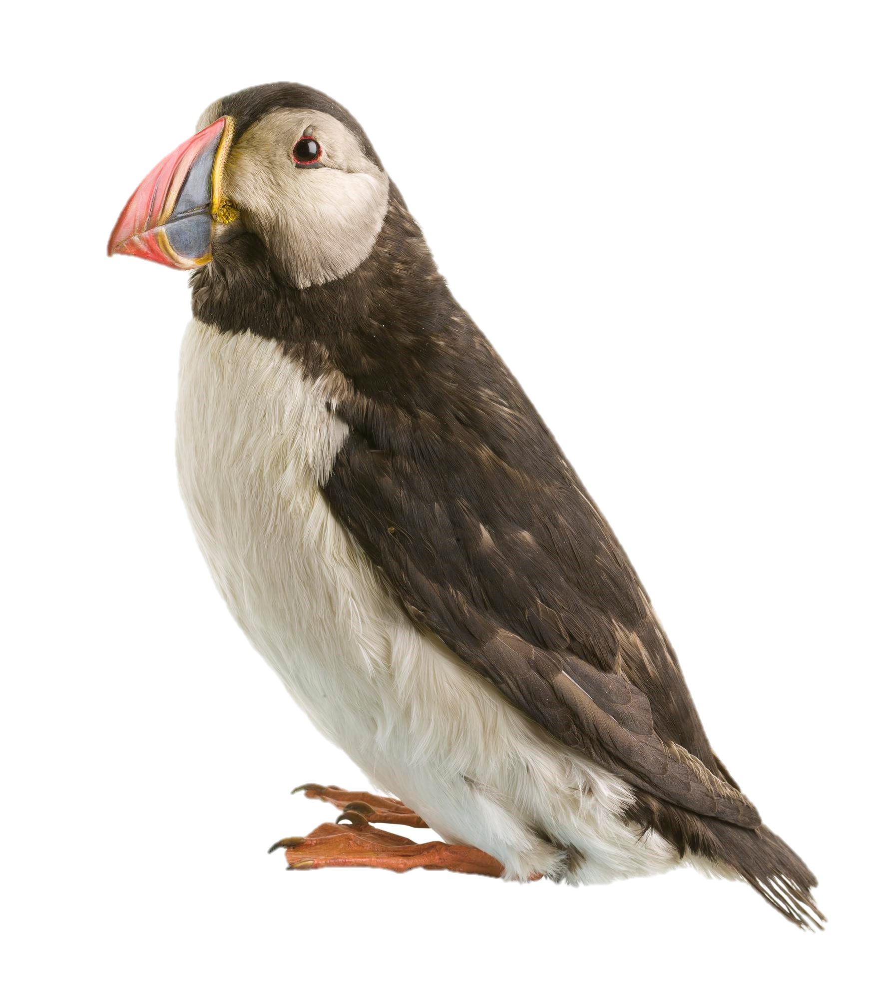
One of Chief Chebe’s tales from his museum tour included a story about how the tortoise came to be so slow and wise.
In groups, create and act out a short story about how an animal got a special characteristic or physical feature. Examples could include:
How the Puffin got its colourful beak
How the Elephant got its trunk
How the Cheetah became so fast
How the rabbit got its hop

Slide 7
Activity 3: Reflection
Have a class discussion. You can use these four questions.

Slide 8
How would you describe Chief Chebe as a storyteller? What adjectives describe his style?
Which animal or story was your favourite? Why?
Chief Chebe told a story about a Tortoise and how it became slow and wise. Do you think this story was meant to teach us something? If so, what might the lesson have been?
Chief Chebe was telling stories using objects and movement, rather than reading from a book. Did you like this way of storytelling? What did you think was good about it?

Slide 9
Museum Story Two
Chief Chebe’s story of Kofi

Slide 10
Activity 1:
Create a story where a character learns a lesson

Slide 11
Chief Chebe’s story about Ghanaian Independence celebrations had the main character learn a lesson.
Create a story where the main character learns an important lesson. Think about what those lessons might be, for example:
Learning not to compare themselves to others but instead, recognising their own strengths
Learning how helping others feels good (just like in Chief Chebe’s story)
Learning that when you’re sad, telling your friends and people close to you can help you feel better
Learning that saying mean things to people makes everyone feel sad

Slide 12
Activity 2:
Collecting stories

Slide 13
In Chief Chebe’s story, the boy learns an important lesson from his father.
Interview people you live with, using the question - What’s the best lesson you have learned from someone else?
Share this with the class. Create a positivity poster or piece of art to show all the different things that people said.

Slide 14
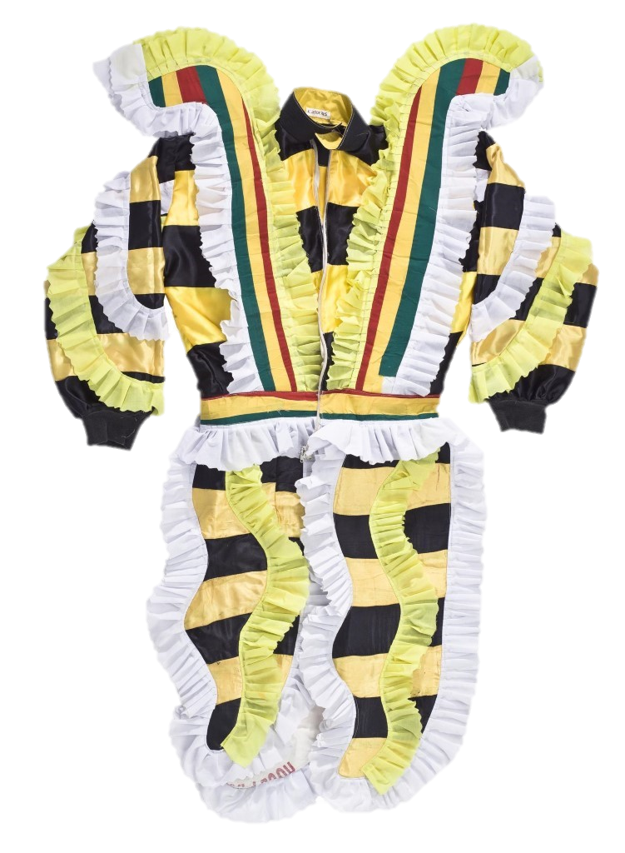
Activity 3:
Create a descriptive story or make a poster about an important celebration

Slide 15
In his story, Chief Chebe describes Ghanaian Independence day celebrations as the most important and happy day in the Ghanaian calendar, filled with colour and joy.
As a class, share any special days or celebrations that you celebrate during the year? What are they about, what do you do, what’s the best thing about them?
Pick one day or celebration and write a short story or piece of writing that explains why it’s so special. Or create a poster that shows what the celebration is and shares all the best bits about it.

Slide 16
Activity 4: Reflection
Have a class discussion about what they saw. You can use these four questions.

Slide 17
What did you think of the costumes? What words could you use to describe them?
Chief Chebe’s story was set in Ghana. What do you know about Ghana? What would you like to know? How could you find out more?
At the end of the story, the boy learned an important lesson. Can you explain in your own words what he learned?
Chief Chebe used call and response at the start of the session (a traditional storytelling method in Africa). Did you enjoy this? How might it make a story more interesting for the people listening?

Slide 18
Tell us what you thought!
Twitter: @NtlMuseumsScot
Email: schools@nms.ac.uk

