Slide 1

Grouping Young People by engagement with heritage

Slide 2
Combining:
Level of interest in heritage and
Agreement with ‘I am not a museum type of person’
To produce 4 ‘segments’…
Neither interested in heritage nor a museum person
Interested in heritage and a museum person
A museum person but not interested in heritage
Interested in heritage but not a museum person
Base: All respondents (500) B3 - When we talk about heritage we mean places and collections of objects which inspire people to learn more about their own past, or that of others. How interested would you say you are in heritage? C8_3 - I am not a museum type of person - How much do you agree or disagree with the following statements about museums?

Slide 3
Motivations for engaging with museums (Indexed)*
Base: All respondents (500) C9 - We want to know how museums can encourage young people like you to visit them. Which, if any, of the following do you think museums should offer/enable you to do? *Indexed against average % mentions for each group
Notes:
The key motivations which differentiate the groups from each other are;
Interested in heritage and a museum person:
↑↑↑ Bring stories/heritage to life
↑↑ Learn about the stories of the people & place I am visiting
↑↑ A unique experience I can't get anywhere else
↑ A friendly, genuine welcome
Interested in heritage but NOT museum person:
↑↑↑↑ Be entertaining
↑↑↑ Bring stories/heritage to life
NOT Somewhere to rest and relax
NOT interested in heritage but is a museum person:
↑↑ Activities with a 'wow' factor
↑↑ Make me feel inspired
NOT interested in heritage and NOT a museum person:
↑↑↑↑↑ Activities with a 'wow' factor
↑↑↑↑↑ Be entertaining
↑↑↑↑ A unique experience I can't get anywhere else
NOT Somewhere to rest and relax

Slide 4
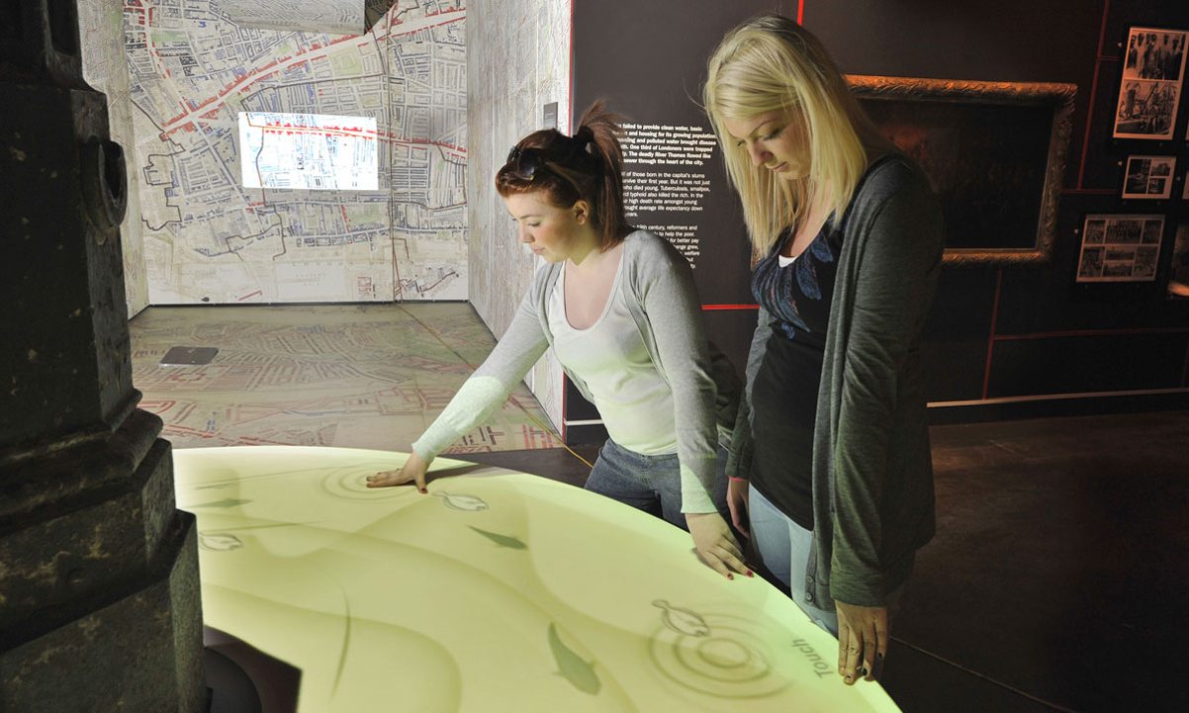
Interested in heritage and a museum person ‘Culture Seekers’
35% (c. 246,000 people*)
Gender
Age
↑
Highest qualifications
Work status
↓
< Level 1
Level 1-2
Level 3+
2%
39%
57%
Education/ training
Working
Not working
Other/NA
Demographics
Social grade
54%
38%
6%
2%
↑
↓
↓
↑
↓
Motivations:
↑↑ Bringing heritage to life
↑ Learning the stories of people and places
↑ Learn something new
↑ Unique experiences
Friendly, genuine welcome
Think museums are:
↑ ↑ Educational
↑ Important
Welcoming
Entertaining
↓ Boring
But:
↑↑↑ Old fashioned
↑↑ For older people
Too quiet
Want to see:
↑↑ Interesting temporary exhibitions
↑↑ Permanent collections kept fresh
↑ Interactive exhibits
After hours/late events for young people
↑ Live events
Base: All interested in Heritage at B3 and disagree with C8_3 ‘I am not a museum type of person’ (175) * Number of people estimate based on population estimates from Scotland’s Census 2011
Notes:
This group is the most engaged with museums and are most likely to visit in the future. Heritage is important to them and they appreciate the role that museums play in protecting heritage – for this group it is about further strengthening engagement and giving them a reason to visit more frequently, keeping things fresh and letting them know what’s on and where to visit, plus really bringing stories and heritage to life
More likely to be females, older, higher social grade and have qualifications L3 or above
Key motivations for engaging with museums are to bring heritage to life and learn the stories of the people and places where they live, unique experiences and friendly atmosphere
More likely to think museums are important, welcoming, fun, entertaining, exciting and not boring
But, they can be old fashioned, for older people and too quiet
They want to see museums offering temporary collections about things they are interested in,

Slide 5
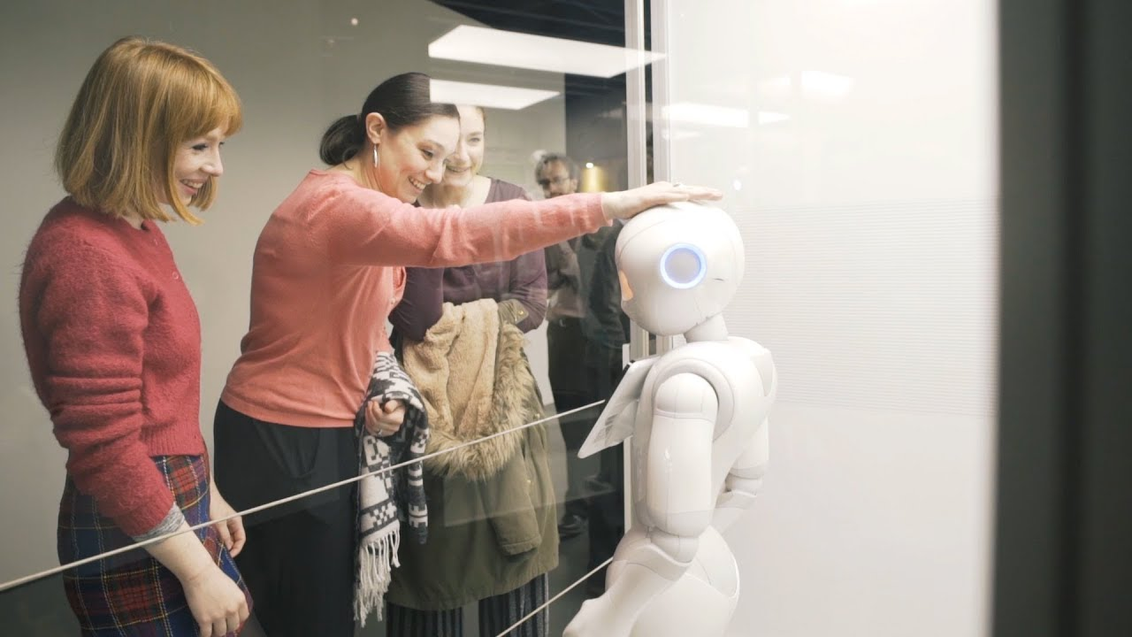
Interested in heritage and a museum person ‘Culture Seekers’
PAST
Loved going when younger with family (and extended family – multi generational) as well as school trips
Always been engaged and loved learning about heritage
Felt comfortable in the space – welcomed and a feeling that they belong
PRESENT
On-going relationship with the space and their overall learning
Love seeing ‘old’ presented in new, unique ways and the space they know so well used in different ways
Museums and heritage still fuels their curiosity
Feel welcomed, comfortable and at home in the space (they always have)
FUTURE
Inspired and interested in seeing museums and heritage evolve in new and different ways
Want to continue to be inspired and surprised and learn new facts and information
Appreciate having their loyalty rewarded
Curious about a potential career
POSSIBLE BARRIERS
Lack of innovation – not taking enough risks
Not enough depth within exhibits, content can sometimes be too broad
They go more regularly so additional or expensive costs can be a barrier!

Slide 6
Culture Seekers
PAST
“We’ve always done culture, with my mum especially. In a way mum pushed it down my throat – photography, museums, Tate, theatre, Southbank. Even though we always had to do it I love it” (Male,22)
“I link museums to childhood” (Male 19)
“I’ve been going to museums since age 5, and we still go as a family” (Female 16)
“My dad took me to museums until I was a teen. Now I take visitors to the city” (Male 22)
“We went in all the school holidays as a kid, I’ve got really good memories” (Male 22)
PRESENT
“Going there appeals to my inner child” (Male, 19)
“Museums are escapism. We forget about what’s going on, just not thinking about anything else” (Female, 19)
“I like it when museums are interactive and there’s a fun element important. Playful, makes it more interesting and you’re more likely to take something away. (Male, 22)
FUTURE
“I like the museum experience – I don’t want a takeover – just want it to be comfortable, so that we feel like we belong in the space – not just kids or old people” (Male, 22)
“I like them, but Museums feel aimless sometimes. Maybe suggest a route - different routes to see different things” (Male, 22)
“I like idea of recreating historical moment – drinks, food and enjoy, something a bit different” (Male, 19)
“If there was an app, I would download it, giving you information about everything and you could select interest filters” (Male 19)
“I’d like there to be hands on activities not just for 5-year olds. To help develops skills and talent” (Female, 19)
“We would get involved in things. People are desperate for experiences” (Female 16)
“We don’t look at the website – if they create Instagram able walls or statues people would tag and that’s how we’d find out” (Female, 16)
“We like a café- sofas, tables, more inclined to get coffee. At the moment, it doesn’t look inviting/ relaxing so would be inclined to go somewhere else, we want q nice vibe (Male, 22)
“I’m in interested in Lost Glasgow (Male, 22)
Notes:
Past
“We’ve always done culture, with my mum especially. In a way mum pushed it down my throat – photography, museums, Tate, theatre, Southbank. Even though we always had to do it I love it”. (Male,22)
“I link museums to childhood. I like National Museum – seeing Scottish things like words found in highlands. And I like seeing inventions, rockets, computers” (Male 19)
“I’ve been going to museums since age 5, and we still go as a family” (Female 16)
“My dad took me to museums until I was a teen. Now I take visitors to the city. It can be interesting. Depends” (Male 22)
“I’ve been loads around NMS and now every place I visit I go to museum. We went in al the school holidays as a kid, I’ve got really good memories” (Male 22)
Present
“Me and girlfriend go to Museums now, but I don’t do it with mates” (Male, 22)
“Now when I go away, I go to museum and galleries – I really appreciate it, it helps you understand the culture of where you are” (Male, 22)
“Going there appeals to my inner child- the silver plates, coins and armour – but I still love battles. I’m into inventions as well and Lucy is always happy to come with” (Male, 19)
“Going as a child is interesting but you miss stuff. And it does change – but you only know this if you go a lot. I went to the exhibition on video games – because I heard about it when I was in the museum.” (Male, 19)
“Museums are escapism. We forget about what’s going on, just not thinking about anything else” (Female, 19)
“I know way around, it is still the same, went with a friend the other week, popped in for an hour but they could change it up a bit” (Female, 16)
“When I went interrailing as an adult I visited the museums in those countries.” (Male, 22)
“I like it when museums are interactive and there’s a fun element important. Playful, makes it more interesting and you’re more likely to take something away. Don’t want to read everything, especially when you’ve been reading loads at uni” (Male, 22)
Future
“I like the museum experience – I don’t want a takeover – just want it to be comfortable, so that we feel like we belong in the space – not just kids or old people” (Male, 22)
“I like to think of myself as cultured. I go when people come and visit for first time, but you need to promote awareness about what’s going on, especially if there are new exhibitions as we don’t expect it to change”
“I like them, but Museums feel aimless sometimes. Maybe suggest a route - different routes to see different things” (Male, 22)
“I would love to go late and night – like Night at Museum. Make it feel like it’s for adults not just young kids. I associate it with taking my cousin and old people, even though we go together a lot” (Female, 19)
“I like idea of recreating historical moment – drinks, food and enjoy, something a bit different” (Male, 19)
“They could do pop ups on a variety of things -technology, WW2 to now, 1940s Edinburgh, fashion, gender” (Girl, 19)
“If there was an app, I would download it, giving you information about everything and you could select interest filters” (Male 19)
“I’d like there to be hands on activities not just for 5-year olds. To help develops skills and talent” (Female, 19)
“I’d love to do classifying and curating” (Male, 19)
“We would get involved in things. People are desperate for experiences” (Female 16)
“We don’t look at the website – if they great Instagram able walls or statues people would tag and that’s how we’d find out” (Female, 16)
“We like a café- sofas, tables, more inclined to get coffee. At the moment, it doesn’t look inviting/ relaxing so would be inclined to go somewhere else. We want nice vibe and quality products at student prices” (Male, 22)
“I’m in interested in Lost Glasgow of 20s and 30s. I want to know about migration and things that shaped Scotland” (Male, 22)
“Could we use it as resource? Archives?” (Male, 22)

Slide 7
Culture Seekers
35%
Motivations for engaging with museums
Index*
Relative prevalence of motivations for engaging with museums for the ‘Culture Seekers’, showing which motivations are most prevalent (highest index) or least prevalent (lowest index) compared to the average for this group
Base: All interested at B3 and disagree with C8_3 (175) C9 - We want to know how museums can encourage young people like you to visit them. Which, if any, of the following do you think museums should offer/enable you to do? * Indexed against average mentions for group

Slide 8
Culture Seekers
35%
Museums are
Index*
Relative prevalence of attitudes to museums for the ‘Culture Seekers’, showing which attitudes are most prevalent (highest index) or least prevalent (lowest index) compared to the average for this group
Base: All interested at B3 and disagree with C8_3 (175) C7 Which, if any, of these words or phrases would you associate with museums?

Slide 9
Culture Seekers
35%
Ways of engaging with museums
Index*
Relative prevalence of ways of engaging with museums for the ‘Culture Seekers’, showing which are the most prevalent (highest index) or least prevalent (lowest index) compared to the average for this group
Base: All interested at B3 and disagree with C8_3 (175) C11 What would encourage you to visit museums/visit more often? * Indexed against average mentions for group

Slide 10
Culture Seekers
35%
Agreement with statements
It is important that young people find out about their heritage
History of a place and where we have come from is important to me
Looking after our heritage is important for creating jobs and boosting the economy
It’s important to protect heritage places even though I may never visit them
Heritage is irreplaceable
Celebrating heritage is important
NET agree
91%
↑
87%
↑↑
91%
↑↑
89%
↑
73%
↑
93%
↑↑
NET disagree
3%
5%
2%
3%
7%
1%
Base: All interested at B3 and disagree with C8_3 (175) B4 - How much do you agree or disagree with the following statements?
Indicates high index versus average for this group for strong agreement with statement
Notes:
Agreement with all statements is higher than average
Highest agreement that heritage irreplaceable and it’s important to protect heritage places – key defining features of this group
This group in particular over-indexes for strong agreement with ‘Heritage is irreplaceable’ and ‘It’s important to protect heritage places even though I may never visit them’

Slide 11
Culture Seekers
35%
Agreement with statements
There is too much focus on protecting heritage and the past when we should be looking forwards
There is never any information on heritage topics that interest me
I don’t know what heritage places there are to visit in my area
Heritage is just about facts and dates and is not interesting
NET agree
29%
38%
13%
27%
NET disagree
58%
↑
51%
↑
81%
↑
56%
↑
Base: All interested at B3 and disagree with C8_3 (175) B4 - How much do you agree or disagree with the following statements?
Notes:
The Museum Motivated group are most likely to know where to visit (51% disagree with ‘I don’t know what heritage places there are to visit in my area’), so lack of awareness is less of a barrier for this group

Slide 12
Culture Seekers
35%
Agreement with statements
Museums have an important role in protecting our heritage
You don't just have to go to a museum to get involved with heritage
I feel intimidated by museums
Museums are too intellectual and not cool
NET agree
95%
↑↑
84%
↑
11%
↓
3%
↓
NET disagree
2%
10%
82%
↑
90%
↑
Base: All interested at B3 and disagree with C8_3 (175) C8 How much do you agree or disagree with the following statements about museums?
Indicates high index versus average for this group for strong agreement with statement
Notes:
Particularly likely to see museums as having an important role in protecting heritage

Slide 13
Culture Seekers
35%
Visiting:
Likelihood to visit a museum in future:
Visited NMS:
71%
14%
10%
18%
↑
National Museum of Scotland
National Museum of Flight
National Museum of Rural Life
National Museum of War
↑
NET likely
98%
Heritage engagement
↑
Mean rating last museum visit:
Last museum visit impact:
Last museum visit with:
8.0/10
68% scored 8-10
By myself
With family;
Partner
Children
Friends
Classmates
14%
64%
29%
3%
26%
1%
↑
Learned something new
A greater appreciation of my heritage and culture
A better understanding of other peoples' ideas
Learned new things about myself and my history
Gained knowledge to use in my work/studying
A better understanding of the community I live in
Developed a new interest
Changed my mind about something
64%
39%
32%
29%
26%
25%
18%
13%
↑
↑
↑
are interested in working in museums sector
↑
70%
↑
↓
Base: All interested at B3 and disagree with C8_3 (175)
Notes:
Most likely to have visited historic places and most likely to have visited the National Museum of Scotland and the National Museum of War
Last museum visit more likely with their partner or friends but least likely with classmates
Highest rating for last visit to a museum
Most likely to visit museums in the future and working in the sector appeals to them

Slide 14
Culture Seekers
35%
Motivation for last museum visit
Index*
Relative prevalence of motivation for last museum visit for the ‘Culture Seekers’, showing which are most prevalent (highest index) or least prevalent (lowest index) compared to the average for this group
Base: All interested at B3 and disagree with C8_3 (175) C2 - What was the reason for your last visit to a museum?

Slide 15
Culture Seekers
35%
Interests in last year
Very/quite interested in
Base: All interested at B3 and disagree with C8_3 (175) A1 - Firstly we would like to know a bit more about you and your interests. Which, if any, of the following have you done in the last year?
Base: All interested at B3 and disagree with C8_3 (175) A2 How interested are you in the following topics?

Slide 16
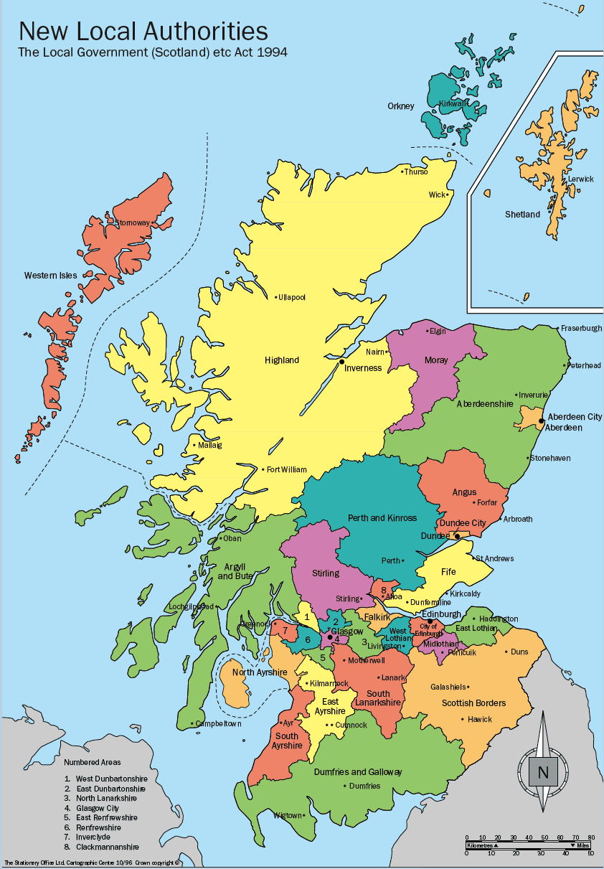
Culture Seekers
35%
Region
Base: All interested at B3 and disagree with C8_3 (175) S1b Which region of Scotland do you live in? D8 Please enter the first part of your postcode
Region

Slide 17
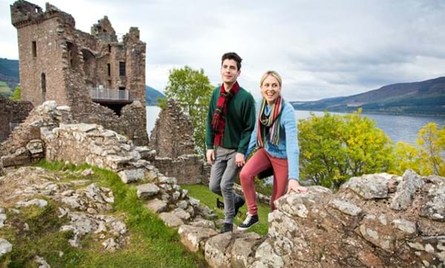
Interested in heritage but NOT a museum person ‘Connection Seekers’
28% (c. 197,000 people*)
Gender
Age
Highest qualifications
Work status
↓
< Level 1
Level 1-2
Level 3+
3%
48%
45%
Education/ training
Working
Not working
Other/NA
↑
↑
48%
37%
12%
4%
Demographics
↑
Social grade
Motivations:
↑↑↑↑ Be entertaining
↑↑↑ Bring stories/ heritage to life
↑↑ Learn something new
↑ Broaden my mind
↓ Rest and relaxation
Think museums are:
↑↑↑ Educational
↑ Important
Welcoming
But:
↑↑ Old fashioned
↑↑ For older people
↑ Boring
↑ Too quiet
Want to see:
↑↑↑ Interesting temporary exhibitions
↑↑ Permanent collections kept fresh
Interactive exhibits
Live events
Base: All interested in Heritage at B3 and do NOT disagree with C8_3 ‘I am not a museum type of person’ (141) * Number of people estimate based on population estimates from Scotland’s Census 2011
Notes:
This group are interested in heritage but don’t connect with museums currently – they are primarily seen as educational spaces and not for them.
They want museums to really bring heritage to life for them, so that they can make a connection and stimulate their thinking.

Slide 18
Interested in heritage but NOT a museum person ’Connection Seekers’
PAST
Liked some museums but more so places of heritage that would bring history to life in fun and exciting ways
Loved old fashioned, theatrical story telling
Often didn’t feel that comfortable at museums – could be too quiet or ‘grown up’
And not interactive or involving enough
PRESENT
Currently prefer and feel ‘more at home’ in places of heritage like castles - where they can/want to explore
Don’t feel as welcome in museums – not a place where they can relax, feel
comfortable
Can find museums too passive and not interactive/immersive enough
FUTURE
Want to get their ‘hands dirty’ and feel what it was like in the past
Looking for more ways to actively get involved and want/would like to have more of a multi-sensory experience rather than just visual
Would be interested in more immersive/interactive productions
POSSIBLE BARRIERS
Museums can require too much effort
Often not participatory/immersive enough and can lack excitement
Need to connect with the exhibition theme quickly which isn’t always guaranteed in a museum

Slide 19
Connection Seekers
PAST
“I love battles and swords and seeing castles, but I don’t want to see it in museum as much. I’d always do it with my dad and grandad” Male 19
“We don’t think about coming independently of school or family, because that’s what we’ve always done” Male 21
PRESENT
“I Like idea of recreating historical moment – drinks, food an enjoy, something a bit different” Male 19
“You don’t hear about the museums on social media, don’t evening realised there’s an exhibition. We are changing and Museums aren’t changing with us.” Female 19
“When you go to a museum, you feel afraid to touch, not feeling easy about walking about, rules, rigid. Needs to be more relaxed” Male 21
FUTURE
“I’d want to know how Scotland is connected to world” Male 19
“People visiting from other places get more out of coming, but people who live here need a wow factor” Female 21
“Make it fun, make being there feel comfortable” Male 22
Notes:
PAST
“I love battles and swords and seeing castles, but I don’t want to see it in museum as much. I’d always do it with my dad and grandad” Male 19
“It’s nice to see an historical object, paints a picture of where we’re from” Female 19
“We don’t think about coming independently of school or family, because that’s what we’ve always done” Male 21
PRESENT
“Like idea of recreating historical moment – drinks, food an enjoy, something a bit different” Male 19
“You don’t hear about the museums on social media, don’t evening realised there’s an exhibition. We are changing and Museums aren’t changing with us.” Female 19
“I like knowing about Scottish history and what makes us different” Female 21
“When you go to a museum, you feel afraid to touch, not feeling easy about walking about, rules, rigid. Needs to be more relaxed” Male 21
FUTURE
“Would like behind the scenes – dark, torch, theatrical. We’d start together as a tour and then split off in different directions. Would pay £5 or £10” Male 19
“Pop ups to try out a variety of things -technology, WW2 to now, 1940s Edinburgh” female 19
“I’d want to know how Scotland is connected to world
”Needs to have a Scottish link – would like to press buttons – something physical.” Male 19
“I’d like to feel like I was going back. I’d like to know what it was like when my grandparents were young and even before that. How they met, what it was like without TVs, and trams instead of trains” Female 21
“People visiting from other places get more out of coming, but people who live here need a wow factor” Female 21
“A cultural experience, free stuff, memorable, axe throwing. Vikings. Make it fun, make being there feel comfortable” Male 22

Slide 20
Connection Seekers
28%
Motivations for engaging with museums
Index*
Relative prevalence of motivations for engaging with museums for the ‘Connection Seekers’, showing which motivations are most prevalent (highest index) or least prevalent (lowest index) compared to the average for this group
Base: All interested at B3 and NOT disagree with C8_3 (141) C9 - We want to know how museums can encourage young people like you to visit them. Which, if any, of the following do you think museums should offer/enable you to do? * Indexed against average mentions for group

Slide 21
Connection Seekers
28%
Museums are
Index*
Positive attitudes
Negative attitudes
Relative prevalence of attitudes to museums for the ‘Connector Seekers’, showing which attitudes are most prevalent (highest index) or least prevalent (lowest index) compared to the average for this group
Base: All interested at B3 and NOT disagree with C8_3 (141) C7 Which, if any, of these words or phrases would you associate with museums?

Slide 22
Connection Seekers
28%
Ways of engaging with museums
Index*
Relative prevalence of ways of engaging with museums for the ‘Connection Seekers’, showing which are most prevalent (highest index) or least prevalent (lowest index) compared to the average for this group
Base: All interested at B3 and NOT disagree with C8_3 (141) C11 What would encourage you to visit museums/visit more often? * Indexed against average mentions for g41up

Slide 23
Connection Seekers
28%
Agreement with statements
It is important that young people find out about their heritage
History of a place and where we have come from is important to me
Looking after our heritage is important for creating jobs and boosting the economy
It’s important to protect heritage places even though I may never visit them
Heritage is irreplaceable
Celebrating heritage is important
NET agree
84%
↑
76%
↑
77%
↑
78%
↑
68%
↑
79%
NET disagree
2%
8%
8%
5%
11%
5%
Base: All interested at B3 and NOT disagree with C8_3 (141) B4 - How much do you agree or disagree with the following statements?
Notes:
Agreement with all statements is higher than average – this group do see heritage as important

Slide 24
Connection Seekers
28%
Agreement with statements
There is too much focus on protecting heritage and the past when we should be looking forwards
There is never any information on heritage topics that interest me
I don’t know what heritage places there are to visit in my area
Heritage is just about facts and dates and is not interesting
NET agree
43%
↑
47%
35%
↑
45%
↑
NET disagree
33%
30%
46%
30%
Indicates high index versus average for this group for strong agreement with statement
Base: All interested at B3 and NOT disagree with C8_3 (141) B4 - How much do you agree or disagree with the following statements?
Notes:
But they find that that it doesn’t connect with them or feel relevant to their lives

Slide 25
Connection Seekers
28%
Agreement with statements
Museums have an important role in protecting our heritage
You don't just have to go to a museum to get involved with heritage
I feel intimidated by museums
Museums are too intellectual and not cool
NET agree
80%
83%
↑
28%
↓
31%
↓
NET disagree
8%
3%
52%
39%
↓
Base: All interested at B3 and NOT disagree with C8_3 (141) C8 How much do you agree or disagree with the following statements about museums?
Indicates high index versus average for this group for strong agreement with statement
Notes:
Most likely to feel intimidated by museums and see them as too intellectual/not cool. They appreciate museums’ role in protecting heritage, but that can be a barrier to engaging with heritage. That said they do believe that heritage can be engaged with outside of museums (but as seen on last slide, they don’t know where/how)

Slide 26
Connection Seekers
28%
Visiting:
Likelihood to visit a museum in future:
Visited NMS:
National Museum of Scotland
National Museum of Flight
National Museum of Rural Life
National Museum of War
49%
16%
11%
16%
NET likely
72%
Heritage engagement
Mean rating last museum visit:
Last museum visit impact:
Last museum visit with:
7.3/10
45% scored 8-10
By myself
With family;
Partner
Children
Friends
Classmates
16%
50%
18%
8%
22%
13%
Learned something new
A greater appreciation of my heritage and culture
A better understanding of other peoples' ideas
Learned new things about myself and my history
Gained knowledge to use in my work/studying
A better understanding of the community I live in
Developed a new interest
Changed my mind about something
45%
26%
20%
14%
16%
14%
12%
11%
are interested in working in museums sector
45%
↑
Base: All interested in Heritage at B3 and NOT disagree with C8_3 (141)

Slide 27
Connection Seekers
28%
Motivation for last museum visit
Index*
Relative prevalence of motivation for last museum visit for the ‘Connection Seekers’, showing which are most prevalent (highest index) or least prevalent (lowest index) compared to the average for this group
Base: All interested at B3 and NOT disagree with C8_3 (141) C2 - What was the reason for your last visit to a museum?

Slide 28
Connection Seekers
28%
Interests in last year
Very/quite interested in
Base: All interested at B3 and NOT disagree with C8_3 (141) A2 How interested are you in the following topics?
Base: All interested at B3 and NOT disagree with C8_3 (141) A1 - Firstly we would like to know a bit more about you and your interests. Which, if any, of the following have you done in the last year?

Slide 29
Connection Seekers
28%
Region
Base: All interested at B3 and NOT disagree with C8_3 (141) S1b Which region of Scotland do you live in? D8 Please enter the first part of your postcode
Region

Slide 30
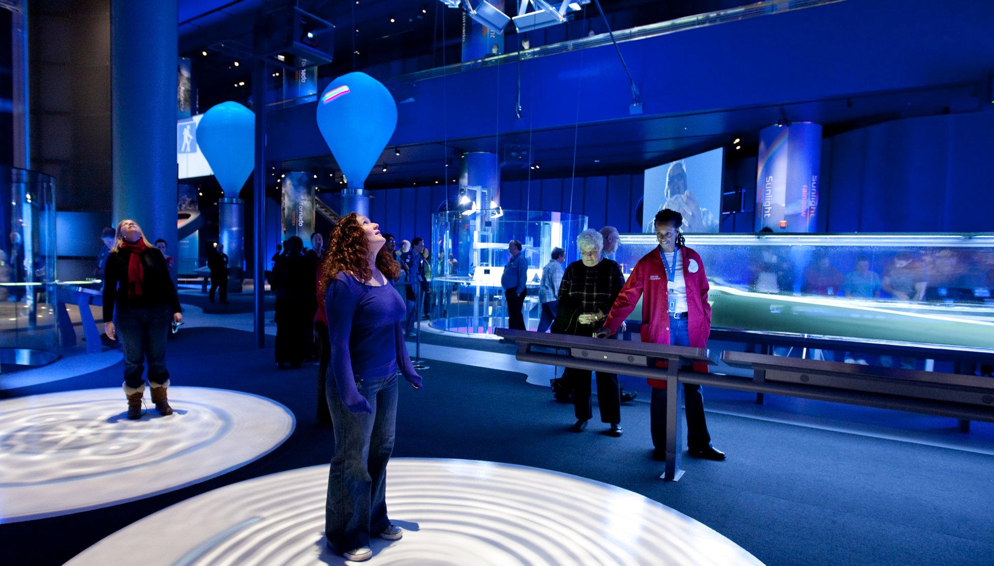
A museum person but NOT interested in heritage ‘Entertainment Seekers’
8% (c. 56,000 people*)
Gender
Age
Highest qualifications
Work status
↓
< Level 1
Level 1-2
Level 3+
2%
59%
37%
Education/ training
Working
Not working
Other/NA
Demographics
Social grade
↑
44%
27%
24%
5%
↑
Motivations:
↑↑ To be inspired
↑↑ ‘Wow’ factor activities
↑ Learn something new
Broaden my mind
But not:
↓↓ Challenge myself
Think museums are:
↑↑ Educational
↑ Exciting
↑ Welcoming
↑ Important
But:
↑↑↑ Old fashioned
↑↑ For older people
↑ For younger people
Want to see:
↑↑ Interesting temporary exhibitions
↑ Permanent collections kept fresh
↑ Interactive exhibits
↑ Digital tech exhibits
↑ Exhibits for young people
Base: All NOT interested at B3 and disagree with C8_3 (415) * Number of people estimate based on population estimates from Scotland’s Census 2011
Notes:
This group like museums but connection with heritage is not important to them. They are looking for inspiration, fun and excitement from museums. Things that ‘wow’ them and stretch their minds, but in a fun way rather than a challenging way.

Slide 31
A museum person but NOT interested in heritage ‘Entertainment seekers’
PAST
Felt museums were old fashioned, not modern or changing
Believed it to be the same every time so not motivated to go more than once
Happy memories of going as kids but not something they did frequently with family
Visits were mainly with school and classmates
PRESENT
Quite like going to museums, infrequently, BUT often wish they had more wow factor
More likely to go to temporary exhibits/ exclusive events- don’t want to miss out
Like exhibitions when they’re relevant to today/future
Always thinking about what’s next and can get bored easily
Want their minds to be broadened, with little effort
FUTURE
To go more often they want to be wowed!
They have FOMO (fear of missing out) often and want to be seen to do what everyone else does
Want to see new, interactive and fresh all the time
Want to see more targeted exhibits to ‘shed new light’ on things they like/find interesting
POSSIBLE BARRIERS
Exhibits they know and have seen not changing
Feel museums don’t have anything new to look at
They don’t feel like museums are for their age so much
Museums can require too much effort

Slide 32
Entertainment seekers
PAST
“I loved going to museums as a kid, was quality time with Granny and grandad Male 20
“I did a lot of culture – with mum, especially photography and art, some museums too, mostly London – as kids she pushed it down our throats but now, I love it” – Male 22
PRESENT
“I like the museum experience – don’t want a takeover – just want it to be comfortable”- Male 22
“It is hard to appreciate it all, if it’s far from your reality” Male 22
“I’m more interested in recent history in the 1960s/1980s - informs debates – we are politically concerned” Male 22
“I like them, but Museums feel aimless sometimes ” Male 22
FUTURE
“Pop ups are interesting – it’s nice to share the experience with someone” Male 20
“FOMO is huge with our generation; you need to go. Something temporary snowballs – people go and enjoy it so it makes other people want to” Male 22
“I’d like there to be temporary exhibitions – first settlers, art, technology, what was bold back in the day – fashion, music – how it has changed, how they lived in past and now” Female 16
Notes:
PAST
“I did a lot of culture – with mum, especially photography and art, some museums too, mostly London – as kids she pushed it down our throats but now, I love it” – Male 22
“I loved going to museums as a kid, was quality time with Granny and grandad Male 20
PRESENT
“I like the museum experience – don’t want a takeover – just want it to be comfortable”- Male 22
“NMS Edinburgh- I haven’t been even though I have lived here for 4 years, been meaning to go. You kind of take it for granted – I have no idea what they offer, never hear about it” --Male 22
“Clans- Jacobite’s, castles- not that interesting an angle. It is hard to appreciate it all, if it’s far from your reality” Male 22.
“I’m more interested in recent history in the 1960s/1980s - informs debates – we are politically concerned” Male 22
“I like them, but Museums feel aimless sometimes – maybe suggest a route” Male 22
“I want to know what’s different to other countries apart from having a castle in the middle of the city “Girl 19
“I saw a banner for a Kayleigh – I thought it was for older people” male 22.
FUTURE
“Pop ups are interesting – it’s nice to share the experience with someone” Male 20
“Good if the entry was cheaper if you booked in advance” Male 22
“FOMO is huge with our generation; you need to go. Something temporary snowballs – people go and enjoy it so it makes other people want to” Male 22
“A chance to do workshops, make it yourself” Female 16
“I’d like there to be temporary exhibitions – first settlers, art, technology, what was bold back in the day – fashion, music – how it has changed, how they lived in past and now” Female 16
“We could have a results celebrations and spooky tour” Female 16

Slide 33
Entertainment Seekers
8%
Motivations for engaging with museums
Index*
Relative prevalence of motivations for engaging with museums for the ‘Inspiration Seekers’, showing which motivations are most prevalent (highest index) or least prevalent (lowest index) compared to the average for this group
Base: All NOT interested at B3 and disagree with C8_3 (41) C9 - We want to know how museums can encourage young people like you to visit them. Which, if any, of the following do you think museums should offer/enable you to do? * Indexed against average mentions for group

Slide 34
Entertainment seekers
8%
Museums are
Index*
Positive attitudes
Negative attitudes
Relative prevalence of attitudes to museums for the ‘Inspiration Seekers’, showing which attitudes are most prevalent (highest index) or least prevalent (lowest index) compared to the average for this group
Base: All NOT interested at B3 and disagree with C8_3 (41) C7 Which, if any, of these words or phrases would you associate with museums?

Slide 35
Entertainment Seekers
8%
Ways of engaging with museums
Index*
Relative prevalence of ways of engaging with museums for the ‘Inspiration Seekers’, showing which are most prevalent (highest index) or least prevalent (lowest index) compared to the average for this group
Base: All NOT interested at B3 and disagree with C8_3 (41) C11 What would encourage you to visit museums/visit more often? * Indexed against average mentions for group

Slide 36
Entertainment Seekers
8%
Agreement with statements
It is important that young people find out about their heritage
History of a place and where we have come from is important to me
Looking after our heritage is important for creating jobs and boosting the economy
It’s important to protect heritage places even though I may never visit them
Heritage is irreplaceable
Celebrating heritage is important
NET agree
41%
↑
46%
↑
44%
↑
34%
↑
29%
↑
61%
NET disagree
24%
7%
17%
7%
17%
7%
Indicates low index versus average for this group for strong agreement with statement
Base: All NOT interested at B3 and disagree with C8_3 (41) B4 - How much do you agree or disagree with the following statements?
Notes:
Low engagement with heritage evident in low agreement with statements

Slide 37
Entertainment Seekers
8%
Agreement with statements
There is too much focus on protecting heritage and the past when we should be looking forwards
There is never any information on heritage topics that interest me
I don’t know what heritage places there are to visit in my area
Heritage is just about facts and dates and is not interesting
NET agree
37%
34%
24%
24%
NET disagree
29%
39%
39%
34%
Base: All NOT interested at B3 and disagree with C8_3 (41) B4 - How much do you agree or disagree with the following statements?

Slide 38
Entertainment Seekers
8%
Agreement with statements
Museums have an important role in protecting our heritage
You don't just have to go to a museum to get involved with heritage
I feel intimidated by museums
Museums are too intellectual and not cool
NET agree
73%
51%
15%
7%
↓
NET disagree
10%
12%
66%
85%
↓
Base: All NOT interested at B3 and disagree with C8_3 (41) C8 How much do you agree or disagree with the following statements about museums?
Indicates high index versus average for this group for strong agreement with statement
Notes:
Although they don’t really engage with heritage, they over index do recognise the importance of museums in protecting it.

Slide 39
Entertainment Seekers
8%
Visiting:
Likelihood to visit a museum in future:
Visited NMS:
61%
12%
12%
12%
↑
National Museum of Scotland
National Museum of Flight
National Museum of Rural Life
National Museum of War
NET likely
83%
Heritage engagement
Mean rating last museum visit:
Last museum visit impact:
Last museum visit with:
7.2/10
39% scored 8-10
By myself
With family;
Partner
Children
Friends
Classmates
10%
66%
20%
0%
15%
10%
Learned something new
A greater appreciation of my heritage and culture
A better understanding of other peoples' ideas
Learned new things about myself and my history
Gained knowledge to use in my work/studying
A better understanding of the community I live in
Developed a new interest
Changed my mind about something
51%
17%
10%
12%
12%
15%
17%
12%
↑
↓
are interested in working in museums sector
↓
41%
Base: All NOT interested in Heritage at B3 and disagree with C8_3 ‘I am not a museum type of person’ (41)

Slide 40
Entertainment Seekers
8%
Motivation for last museum visit
Index*
Relative prevalence of motivation for last museum visit for the ‘Inspiration Seekers’, showing which are most prevalent (highest index) or least prevalent (lowest index) compared to the average for this group
Base: All NOT interested at B3 and disagree with C8_3 (41) C2 - What was the reason for your last visit to a museum?

Slide 41
Entertainment Seekers
8%
Interests in last year
Very/quite interested in
Base: All NOT interested at B3 and disagree with C8_3 (41) A1 - Firstly we would like to know a bit more about you and your interests. Which, if any, of the following have you done in the last year?
Base: All NOT interested at B3 and disagree with C8_3 (41) A2 How interested are you in the following topics?

Slide 42
Entertainment Seekers
8%
Region
Base: All NOT interested at B3 and disagree with C8_3 (41) S1b Which region of Scotland do you live in? D8 Please enter the first part of your postcode
Region

Slide 43
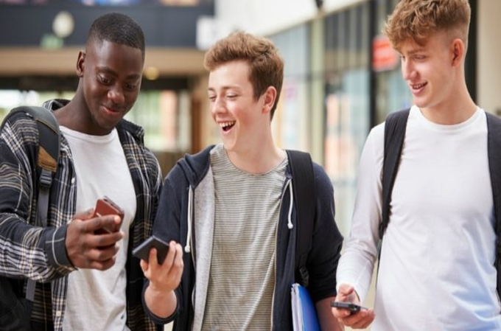
NOT interested in heritage and NOT a museum person ‘Inspiration Seekers’
29% (c. 204,000 people*)
Gender
Age
Highest qualifications
Work status
↓
Education/ training
Working
Not working
Other/NA
< Level 1
Level 1-2
Level 3+
6%
52%
29%
↑
44%
34%
15%
8%
Demographics
Social grade
↑
↑
↑
Motivations:
↑↑↑↑↑ ‘Wow’ factor activities
↑↑↑↑↑ Entertainment
↑↑↑↑ Unique experiences
↑↑↑ Learn something new
But not:
↓↓ Challenge myself
Think museums are:
↑↑↑ Educational
Important
But:
↑↑ Old fashioned
↑↑ Boring
For older people
Want to see:
↑↑↑ Interesting temporary exhibitions
↑ Digital tech
Interactive exhibits
↑ Permanent collections kept fresh
Base: All NOT interested at B3 and NOT disagree with C8_3 (143) * Number of people estimate based on population estimates from Scotland’s Census 2011
Notes:
This group is the least engaged with both heritage and museums. They are looking to be entertained – museums really have to go all out with ‘wow’ experiences they can’t get elsewhere to catch their eye and get them through the door. Tech and interactivity are important in exhibits

Slide 44
NOT interested in heritage and NOT a museum person ‘Inspiration Seekers’
PAST
Didn’t really go that much when they were younger
Possibly went with school
But low engagement
And had no personal drive to visit
Less interested in cultural experiences in general
More motivated by entertainment
PRESENT
Little to no relationship with museums and heritage
Going isn’t really on their radar
Might be motivated to go if a friend (who is into it) tells them about something special/different and then they go together
Need a reason to go which they don’t always/seem to have
FUTURE
Like the idea of fun and social events within a museum – something new and different and a way for them to reconsider going
Like the museum space when in it (but it’s hard to get them there in the first place)
POSSIBLE BARRIERS
No past relationship so it’s hard to build one with them
Will only go if their friends want to – would never think to go otherwise
If they go once why go again/regularly

Slide 45
Inspiration Seekers
PAST
“I’ve been going to museums since age 5, I know way around, it is still exactly the same” Female 16
“I was interested when I was younger, but now there’s a cost. Why should you pay to find out about your past” Male 21
PRESENT
“In a museum or gallery, it reminds me about my heritage, but I wouldn’t seek it out. I’ve got no massive sense of belonging” Male 22
“Going to museums feels like going to a library, there are restrictions on behaviour” Male 21
“I’m not the type of person who goes to a Museum even though I loved it as a kid – just not interested in what’s in that museum” female 21
FUTURE
“I’d like to go to a rave in a museum that would be fun” Male 22
“Make it more of an activity to go and do, interactive and engaging, not just seeing” Male 22
“They could have food – market/ street food – celebrations of other cultures” Female 22
“I would have a go at workshops – Celtic tattoos, hair (vintage), Scottish history related to modern.” Female 21
Notes:
Quotes – please choose which you want in this chart and others will go in the appendix
PAST
“I’ve been going to museums since age 5, I know way around, it is still exactly the same” Female 16
“We went to the transport museum a bit as kids, it was good as it didn’t feel too much like a museum” Female 21
“I was interested when I was younger, but now there’s a cost. Why should you pay to find out about your past” Male 21
PRESENT
“In a museum or gallery -it reminds me about my heritage, but I wouldn’t seek it out. I’ve got no massive sense of belonging” Male 22
“At the mo, the museum café feels a bit liminal like a hospital or airport” Male 22
“Not sure NMS represents many Scottish people – we’re into sport, film, music, books, fashion, whiskey” Male 22
“I’m not into statues, pictures or paintings –– just not interested although I did like the Louvre. I went to see the Mona Lisa, it’s the only thing I wanted to see.” Female 21
“Going to museums feels like going to a library, there are restrictions on behaviour” Male 21
“Haven’t seen any adverts for museums, so don’t think there’s anything new or for me” Male 21
“I’m not the type of person who goes to a Museum even though I loved it as a kid – just not interested in what’s in that museum” female 21
FUTURE
“I’d like to go to a rave in a museum that would be fun” Male 22
“Make it more of an activity to go and do – interactive and engaging – not just see” Male 22
“Could do a show and collaborate with others maybe” Male 20
NMS x Adidas- link to sports. It’ll shake the museum’s image, bring in something on Hip hop or a record label doing something with
Football terrace fashion” Male 18
“We went to Pink Floyd music at Planetarium – everyone wanted to go. We want experiences” Female 20
“They could have food – market/ street food – celebrations of other cultures.” Female 22
“I would have a go at workshops – Celtic tattoos, hair (vintage), Scottish history related to modern.” Female 21

Slide 46
Inspiration Seekers
29%
Motivations for engaging with museums
Index*
Relative strength of motivations for engaging with museums for the ‘Entertainment Seekers’, showing which motivations are strongest (highest index) or weakest (lowest index) compared to the average for this group
Base: All NOT interested at B3 and NOT disagree with C8_3 (143) C9 - We want to know how museums can encourage young people like you to visit them. Which, if any, of the following do you think museums should offer/enable you to do? * Indexed against average mentions for group

Slide 47
Inspiration Seekers
8%
Museums are
Index*
Positive attitudes
Negative attitudes
Relative strength of attitudes to museums for the ‘Entertainment Seekers’, showing which attitudes are strongest (highest index) or weakest (lowest index) compared to the average for this group
Base: All NOT interested at B3 and NOT disagree with C8_3 (143) C7 Which, if any, of these words or phrases would you associate with museums?

Slide 48
Inspiration Seekers
29%
Ways of engaging with museums
Index*
Relative strength of ways of engaging with museums for the ‘Entertainment Seekers’, showing which are most prevalent (highest index) or least prevalent (lowest index) compared to the average for this group
Base: All NOT interested at B3 and NOT disagree with C8_3 (143) C11 What would encourage you to visit museums/visit more often? * Indexed against average mentions for group

Slide 49
Inspiration Seekers
29%
Agreement with statements
It is important that young people find out about their heritage
History of a place and where we have come from is important to me
Looking after our heritage is important for creating jobs and boosting the economy
It’s important to protect heritage places even though I may never visit them
Heritage is irreplaceable
Celebrating heritage is important
NET agree
45%
↑
41%
↑
38%
↑
38%
↑
32%
↑
47%
↑
NET disagree
15%
15%
24%
21%
21%
13%
Base: All NOT interested at B3 and NOT disagree with C8_3 (143) B4 - How much do you agree or disagree with the following statements?
Indicates low index versus average for this group for strong agreement with statement
Notes:
Low agreement across the board, but particularly under-index for strong agreement that the history of a place is important to them and the connection between looking after heritage and the economy – heritage lacks value to them currently

Slide 50
Inspiration Seekers
29%
Agreement with statements
There is too much focus on protecting heritage and the past when we should be looking forwards
There is never any information on heritage topics that interest me
I don’t know what heritage places there are to visit in my area
Heritage is just about facts and dates and is not interesting
NET agree
38%
38%
29%
33%
NET disagree
19%
23%
27%
24%
Base: All NOT interested at B3 and NOT disagree with C8_3 (143) B4 - How much do you agree or disagree with the following statements?

Slide 51
Inspiration Seekers
29%
Agreement with statements
Museums have an important role in protecting our heritage
You don't just have to go to a museum to get involved with heritage
I feel intimidated by museums
Museums are too intellectual and not cool
NET agree
50%
↑
54%
↑
22%
24%
↑
NET disagree
11%
6%
44%
36%
Base: All NOT interested at B3 and NOT disagree with C8_3 (143) C8 How much do you agree or disagree with the following statements about museums?

Slide 52
Inspiration Seekers
29%
Visiting:
Likelihood to visit a museum in future:
Visited NMS:
38%
11%
8%
9%
↑
National Museum of Scotland
National Museum of Flight
National Museum of Rural Life
National Museum of War
↑
NET likely
38%
Heritage engagement
↑
Mean rating last museum visit:
Last museum visit impact:
Last museum visit with:
6.3/10
25% scored 8-10
By myself
With family;
Partner
Children
Friends
Classmates
Can’t remember
10%
46%
13%
3%
16%
14%
16%
↑
Learned something new
A greater appreciation of my heritage and culture
A better understanding of other peoples' ideas
Learned new things about myself and my history
Gained knowledge to use in my work/studying
A better understanding of the community I live in
Developed a new interest
Changed my mind about something
36%
7%
10%
10%
12%
9%
7%
7%
↑
↓
↓
are interested in working in museums sector
↓
14%
↑
↑
↑
Base: All NOT interested at B3 and NOT disagree with C8_3 (143)

Slide 53
Inspiration Seekers
29%
Motivation for last museum visit
Index*
Relative prevalence of motivation for last museum visit for the ‘Entertainment Seekers’, showing which are most prevalent (highest index) or least prevalent (lowest index) compared to the average for this group
Base: All NOT interested at B3 and NOT disagree with C8_3 (143) C2 - What was the reason for your last visit to a museum?

Slide 54
Inspiration Seekers
29%
Interests in last year
Very/quite interested in
Base: All NOT interested at B3 and NOT disagree with C8_3 (143) A2 How interested are you in the following topics?
Base: All NOT interested at B3 and NOT disagree with C8_3 (143) A1 - Firstly we would like to know a bit more about you and your interests. Which, if any, of the following have you done in the last year?

Slide 55
Inspiration Seekers
29%
Region
Base: All NOT interested at B3 and NOT disagree with C8_3 (143) S1b Which region of Scotland do you live in? D8 Please enter the first part of your postcode
Region

Slide 56
Baby Boomers and Gen X
PAST
Most remember liking visits to museums as a child
Something everyone did – competitive set was smaller
Something they all did with school (a predictable outing) and sometimes with their families
When young adults (pre kids) often didn’t feel like it was a place for them – believe you need to have kids to be there so rarely motivated to visit
PRESENT
Museums and heritage now more on their radar
A lovely place for many to visit – they have time and feel it is important especially if they have grandchildren - edutainment at its best and a safe place to take them
Some like going there to meet friends for a coffee
Many just really love the space
FUTURE
Open to seeing and finding new things
Love and want to see temporary exhibits, have new experiences
Like it when they are there they have the time to ‘linger longer’
Love to see/be offered exclusives especially for their age/stage
POSSIBLE BARRIERS
‘Busy’ lives can mean they don’t have the time to visit
Those without children/grand children may find little reason to go, especially those who think that content doesn’t change that much
Feel they won’t see/get new experiences information or ideas
Notes:
Please remember we only did SIX calls with this target so getting the detail you might require isn’t possible and this is therefore only indicative
PAST
“I spent a lot of time at a few museums over years… I like finding out how they did dances, music, their weapons”
Male 66
“I take my grandkids sometimes – but I also like to take them hiking or to the castles and historic sites to get them feeling excited and proud” Male 66.
“My daughter is 27 and we started coming to the museums when she started school. Kelvyn Grove museum became a ritual for us, its my favourite I love all the architecture and then there’s so much to see when you’re there. It’s funny my husband was never interested, because he’s more into practical things although he came with us when we went when my daughter was a child”. Female 55
“My Husband’s Mum was a Murray. They’ve got their own coat of arms, so he’s more passionate about that heritage, and the countryside and castles. He’s proud to be Scottish but doesn’t like going to museums about it, he’s more a castle guy, unless it’s about something more practical or football! I think he thinks they’re a bit unchanging since he was a kid and since our daughter was young. He’d rather go and find out things – he’s coming to the tunnels when we go though.” Female 55
“I remember going to the museums with school, it was a lot of fun going around, filling out questions with friends and having lunch. Something different, something you always remember!” Female 48
PRESENT
“Patrick has got one of those visit museums cards and got me one, encourages me to go. I enjoyed history at school – we missed the modern stuff, just old Scottish history. I like going to the Museum in Glasgow and castles Female 50
“I’ve also got a daughter, she’s 14, she doesn’t want to come with me so much now, but I take the grandkids. She stopped at secondary school; you know what teenagers are like” Male 66
“So, it’s something I do for myself now and with daughter as she was growing up. Now I go for various ideas for work, for projects I’m doing, I do design and love Roman Architecture” Female 55
“Now we’re a bit older, it’s a nice place to have coffee with Scottish friends. Everyone knows where it is, and it’s quiet.” Female 55
“I used to go to special exhibitions. Leonardo da Vinci is on my list of things to do over the Easter Holiday. I find out about things that are on because I subscribe to emails and look on website” Female 55
“I haven’t been to the museums for years. It’s not something I think about or hear about. If I heard about something that was interesting, I probably would go, it’s easy to get to. What’s interesting? I don’t know. I like photography, I like fashion. I’m not sure about Scottish heritage though. It’s not something I think about. Maybe it’s something about Immigrants to Scotland and how people have changed it in a positive way. Maybe that would only interest me. “ Female 48
FUTURE
“I am always up for a Kayleigh if there’s a decent band and money goes to charity. You can rely on people in my generation to support that” Male 66
“I’ve booked us on 2 tours over Easter. 1 is Liverpool in WW2 – everything was co-ordinated at a building a war room; you can do a tour. I looked online. It’s so interesting. My daughter will come too. Its great that we’re into the same things. And if she has kids, we’ll keep it up.
I’ve also booked the Williamson tunnels tour. No one knows why they are there. They’re built. They’re our history.” Woman 55
“It feels good knowing it’s there, and it’s important especially for kids to go. They see things they’ve never seen before and the space is so big” Female, 48

Slide 57
Baby Boomers and Gen X
PAST
“I spent a lot of time at a few museums over years… I like finding out how they did dances, music, their weapons” Male 66
“I take my grandkids sometimes – but I also like to take them hiking or to the castles and historic sites to get them feeling excited and proud” Male 66.
“My daughter is 27 and we started coming to the museums when she started school. It’s funny my husband was never interested, because he’s more into practical things although he came with us when we went when my daughter was a child”. Female 55
“My Husband’s Mum was a Murray. They’ve got their own coat of arms, so he’s more passionate about that heritage, and the countryside and castles. He’d rather go and find out things – he’s coming to the tunnels when we go though.” Female 55
“I remember going to the museums with school, it was a lot of fun going around, filling out questions with friends and having lunch. Something different, something you always remember!” Female 48
PRESENT
“Patrick has got one of those visit museums cards and got me one, encourages me to go. I enjoyed history at school – we missed the modern stuff, just old Scottish history. I like going to the Museum in Glasgow and castles Female 50
“I’ve also got a daughter, she’s 14, she doesn’t want to come with me so much now, but I take the grandkids.” Male 66
“So, it’s something I do for myself now and with daughter as she was growing up. Now I go for various ideas for work, for projects I’m doing, I do design and love Roman Architecture” Female 55
“Now we’re a bit older, it’s a nice place to have coffee with Scottish friends. Everyone knows where it is, and it’s quiet.” Female 55
“I haven’t been to the museums for years. It’s not something I think about or hear about. If I heard about something that was interesting, I probably would go, it’s easy to get to. What’s interesting? I don’t know. I like photography, I like fashion. I’m not sure about Scottish heritage though. It’s not something I think about. Maybe it’s something about Immigrants to Scotland and how people have changed it in a positive way. Maybe that would only interest me. “ Female 48
FUTURE
“I am always up for a Kayleigh if there’s a decent band and money goes to charity. You can rely on people in my generation to support that” Male 66
“I’ve booked us on 2 tours over Easter. 1 is Liverpool in WW2 – everything was co-ordinated at a building a war room; you can do a tour. I looked online. It’s so interesting. My daughter will come too. Its great that we’re into the same things. And if she has kids, we’ll keep it up.
I’ve also booked the Williamson tunnels tour. No one knows why they are there. They’re built. They’re our history.” Woman 55
“It feels good knowing it’s there, and it’s important especially for kids to go. They see things they’ve never seen before and the space is so big” Female, 48
Notes:
PAST
“I spent a lot of time at a few museums over years… I like finding out how they did dances, music, their weapons”
Male 66
“I take my grandkids sometimes – but I also like to take them hiking or to the castles and historic sites to get them feeling excited and proud” Male 66.
“My daughter is 27 and we started coming to the museums when she started school. Kelvyn Grove museum became a ritual for us, its my favourite I love all the architecture and then there’s so much to see when you’re there. It’s funny my husband was never interested, because he’s more into practical things although he came with us when we went when my daughter was a child”. Female 55
“My Husband’s Mum was a Murray. They’ve got their own coat of arms, so he’s more passionate about that heritage, and the countryside and castles. He’s proud to be Scottish but doesn’t like going to museums about it, he’s more a castle guy, unless it’s about something more practical or football! I think he thinks they’re a bit unchanging since he was a kid and since our daughter was young. He’d rather go and find out things – he’s coming to the tunnels when we go though.” Female 55
“I remember going to the museums with school, it was a lot of fun going around, filling out questions with friends and having lunch. Something different, something you always remember!” Female 48
PRESENT
“Patrick has got one of those visit museums cards and got me one, encourages me to go. I enjoyed history at school – we missed the modern stuff, just old Scottish history. I like going to the Museum in Glasgow and castles Female 50
“I’ve also got a daughter, she’s 14, she doesn’t want to come with me so much now, but I take the grandkids. She stopped at secondary school; you know what teenagers are like” Male 66
“So, it’s something I do for myself now and with daughter as she was growing up. Now I go for various ideas for work, for projects I’m doing, I do design and love Roman Architecture” Female 55
“Now we’re a bit older, it’s a nice place to have coffee with Scottish friends. Everyone knows where it is, and it’s quiet.” Female 55
“I used to go to special exhibitions. Leonardo da Vinci is on my list of things to do over the Easter Holiday. I find out about things that are on because I subscribe to emails and look on website” Female 55
“I haven’t been to the museums for years. It’s not something I think about or hear about. If I heard about something that was interesting, I probably would go, it’s easy to get to. What’s interesting? I don’t know. I like photography, I like fashion. I’m not sure about Scottish heritage though. It’s not something I think about. Maybe it’s something about Immigrants to Scotland and how people have changed it in a positive way. Maybe that would only interest me. “ Female 48
FUTURE
“I am always up for a Kayleigh if there’s a decent band and money goes to charity. You can rely on people in my generation to support that” Male 66
“I’ve booked us on 2 tours over Easter. 1 is Liverpool in WW2 – everything was co-ordinated at a building a war room; you can do a tour. I looked online. It’s so interesting. My daughter will come too. Its great that we’re into the same things. And if she has kids, we’ll keep it up.
I’ve also booked the Williamson tunnels tour. No one knows why they are there. They’re built. They’re our history.” Woman 55
“It feels good knowing it’s there, and it’s important especially for kids to go. They see things they’ve never seen before and the space is so big” Female, 48

Slide 58
Baby Boomers and Gen X
It’s more about Museums playing different roles in their lives
As kids they were more passive recipients and would go when they’re taken
They enjoyed it and it was a part of the rich tapestry of childhood
As adults they are more actively seeking out things to do: as adults, as parents and as grandparents
  Museums feel welcoming to each of these stages
Keen museums goers have stayed engaged and adapted to suit their lifestyle/life stage
Whereas less engaged are likely doing other things, other cultural activities and don’t really think about Museums as much – museums aren’t currently reaching them as adults
But they do know they’re good to do as parents and grandparents
  Activities for them need to be more about connecting with them at this life stage
    Like museums being an interesting place to meet friends for coffee
    Taking/spending time with their grandkids/kids (even if they’re a bit older, something for everyone)

